Slide 1
CLAIT ADVANCED
UNIT 5
Professional e-Presentation
PowerPoint 2013 & 2016
Presented By
Andrew Stretton
November 2017
CS

Slide 2

CONTENTS
Section 1 Preparation | Section 2 Images & Drawn Objects | Section 3 Charts & Tables | Section 4 Multimedia | Section 5 Slide Shows | Section 6 Macros | Section 7 Finishing & Printing
Styles Preparation 1a. Style Sheet | 12. Text Boxes & Drawing Objects | 18. Organisation Charts | 24. Inserting Sounds | Inserting Slides 29a. Inserted Slide 1 29b. Inserted Slides 2 | 39. Macros | 44. Adding Speaker’s Notes
2. The Slide Master | 13. Object Backgrounds | 19. Formatting Organisation Charts | 25. Inserting Movies | 30. Hiding Slides | 40. Running Macros | 45. Start & End Slides
3. Bullet Levels | 14. Inserting WordArt | 20. Inserting Tables | 26. Animation | 31. Custom Shows | 41. Multiple Action Macros | 46. Summary Slides
4. Line Spacing & Paragraph Spacing | 15. Inserting Online Pictures | 21. Inserting Charts | 27. Animation Sequences | 32. Running Custom Shows | 42. Assigning Macros | 47. Perfecting A Presentation
Layout Masters | 16. Inserting Pictures From File | 22. Formatting Charts | 28. Animating Charts | Action Buttons 33a. Links Applied | Modifying Macros | Printing Slides 48a. All Slides 48b. Current Slide 48c. 2 Copies 48d. Handouts 48e. Notes Pages
6. Notes Page Masters | 17. Inserting Animated Clips | 23. Importing Charts | 28a. Assessment | 34. Editing Action Buttons | 43a. Assessment PPT 2016
7. Colour Schemes | 17a. Assessment | 23a. Assessment |  | Hyperlinks In Slides
8. Background Effects |  |  |  | 36. Applying Transitions |  | 49. Package For CD
9. Creating A Template |  |  |  | 37. Applying Timings |  | 50. Publishing To The Web
10. Using A Template |  |  |  | 38. Slide Shows |  | 50a. Assessment
11. Slide Design & Setup |  |  |  | 38a. Assessment 1 Assessment 2
11a. Assessment
TS

Slide 3
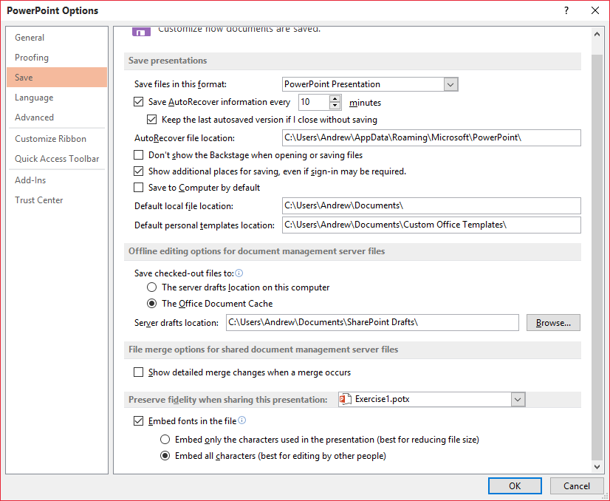

Section 1 Preparation Exercise 1 Styles Preparation
CS
Screen Print Evidence for 2d Objective of the Evidence Checklist:
Embedding all characters from the File Tab’s Options, then the Save Selection from the PowerPoint Options Dialog Box, then the Embed Fonts In The File Selection, Embed all characters (best for editing by other people) Selection, then the OK Button.
Used in the case of another PC not having the original fonts installed then the presentation will still be able to display the Font Styles correctly.
Assessment
Checklist

Slide 4
Section 1 Preparation Exercise 1a Style Sheet
CS
Screen Print Evidence for 2d Objective of the Evidence Checklist:
Style Sheet
Style Name | Font | Line Spacing | Paragraph Spacing | Size | Colour | Alignment | Emphasis
Title Style | Arial | 1.25 | Before 0. pt after 0.3 pt | 32 pt | Red | Left | Shadow
Assessment
Checklist

Slide 5
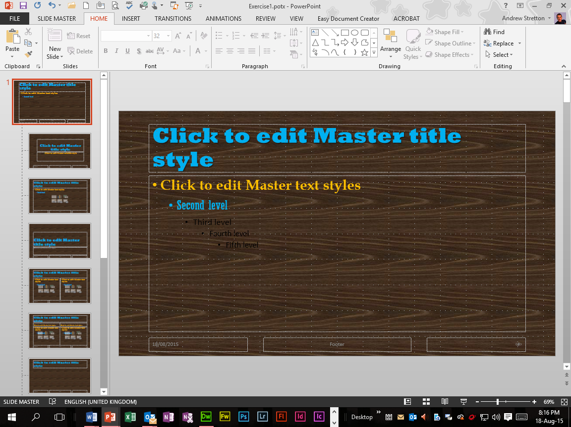
Section 1 Preparation Exercise 2 The Slide Master
CS
Screen Print Evidence for 2a, 2c and 2e Objectives of the Evidence Checklist:
Slide Master Template Exercise1.potx Presentation with a Walnut Background including Fonts and Sizes along with enhancements.
Rockwell Extra Bold, Size 48, Light Blue & Shadowed
Book Antiqua, Size 32, Gold & Bold
Rockwell Condensed, Size 28
& Light Blue
Assessment
Checklist

Slide 6
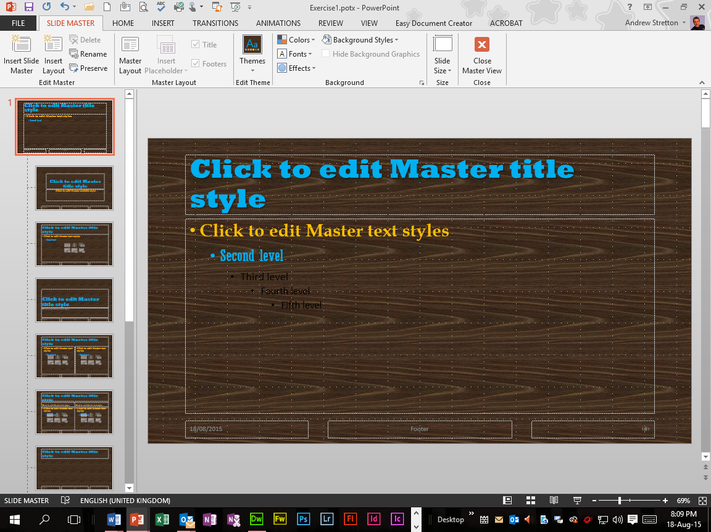
Section 1 Preparation Exercise 3 Bullet Levels
CS
Screen Print Evidence of:
Slide Master Template Exercise1.potx Presentation with a Walnut Background and Bullet Levels.

Slide 7
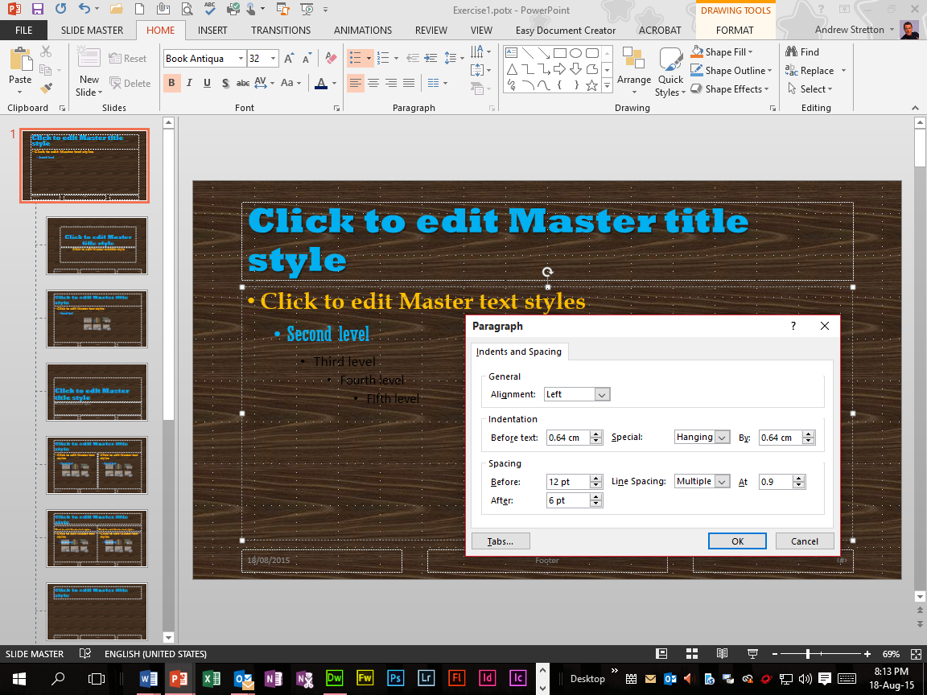
Section 1 Preparation Exercise 4 Line Spacing & Paragraph Spacing
CS
Slide Master
Screen Print Evidence of:
Slide Master Template Exercise1.potx Presentation with a Walnut Background, then Line and Paragraph Spacing from the Paragraph Section’s Dialog Box Launcher.

Slide 8
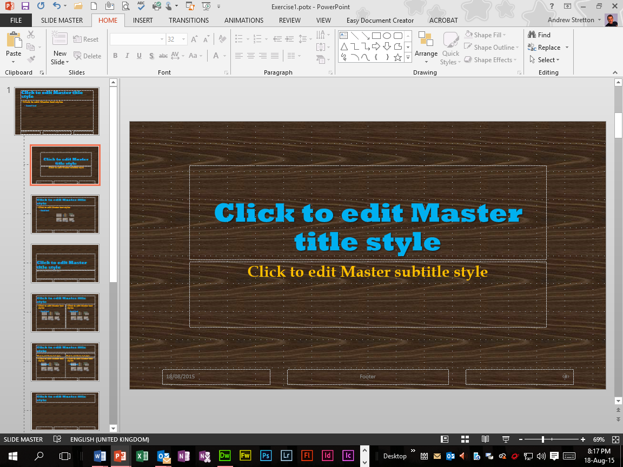
Section 1 Preparation Exercise 5 Layout Masters
CS
Title Slide Master
Screen Print Evidence for 2a, 2c and 2e Objectives of the Evidence Checklist:
Title Slide Master Template Exercise1.potx Presentation with a Walnut Background including Fonts and Sizes along with enhancements.
Rockwell Extra Bold,
Size 54, Light Blue & Shadowed
Book Antiqua, Size 32, Gold & Bold
Assessment
Checklist

Slide 9
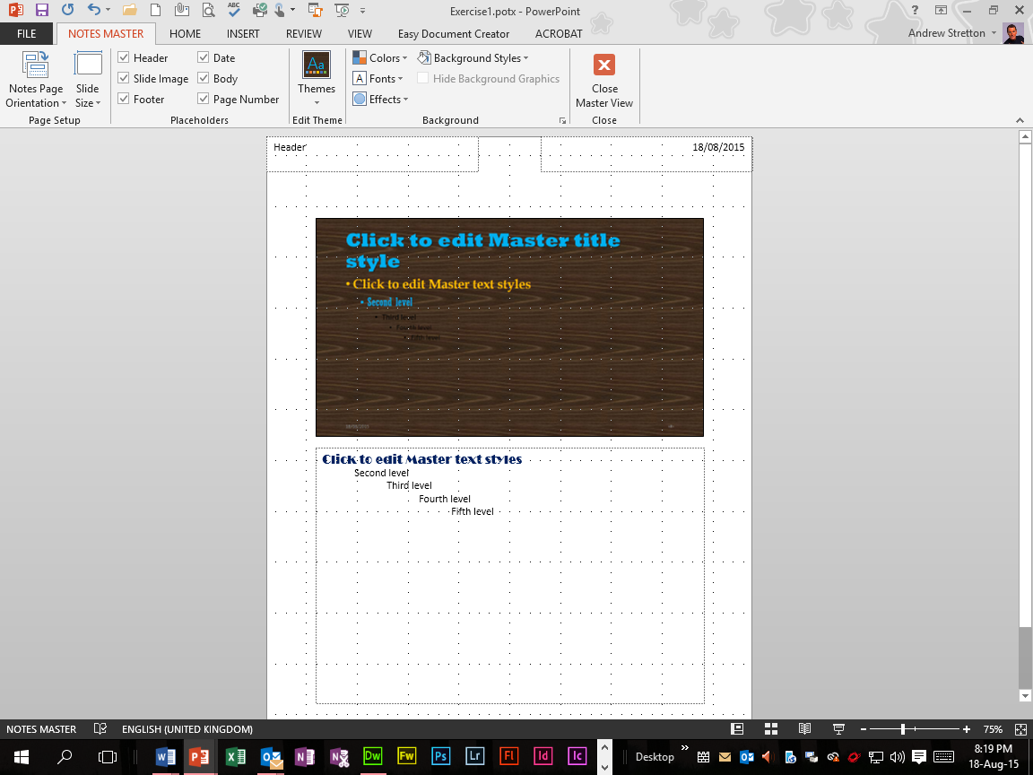
Section 1 Preparation Exercise 6 Notes Page Masters
CS
Notes Page Master
Screen Print Evidence for 2a, 2c and 2e Objectives of the Evidence Checklist:
Notes Page Master Template Exercise1.potx Presentation with a Walnut Background including Font and Size.
Broadway, Size 14
Assessment
Checklist

Slide 10
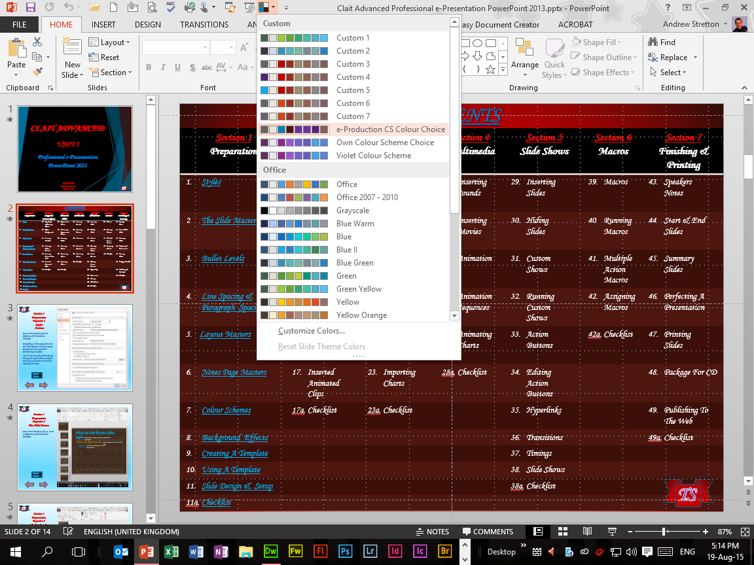
Section 1 Preparation Exercise 7 Colour Schemes
CS
Screen Print Evidence of:
Colour changes applied to my Clait Advanced Professional e-Presentation Contents Slide from the Variants Group Custom Colours Selection.

Slide 11

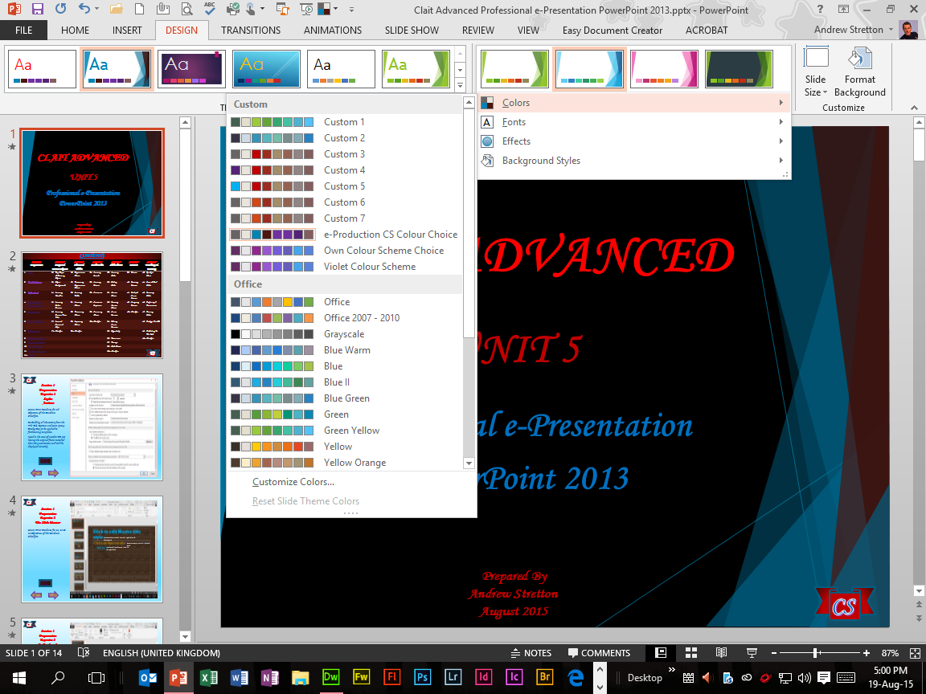
Section 1 Preparation Exercise 8 Background Effects
CS
Screen Print Evidence for 2e Objective of the Evidence Checklist:
White Marble Background Effect applied to this Slide Background from the Format Background Pane’s Picture Or Text Fill Selection, then the Texture Button, then the White Marble Selection.
A Facet Theme with my own colour changes applied to my Clait Advanced Professional e-Presentation Title Slide Screen Print from the Variants Group Custom Colours Selections.
Assessment
Checklist

Slide 12

Section 1 Preparation Exercise 9 Creating A Template
CS
Screen Print Evidence for 2b Objective of the Evidence Checklist:
Exercise1.potx Template Saved As and displayed in the Title Bar.
(SECOND TEMPLATE WITHIN SECTION 2)
Assessment
Checklist

Slide 13
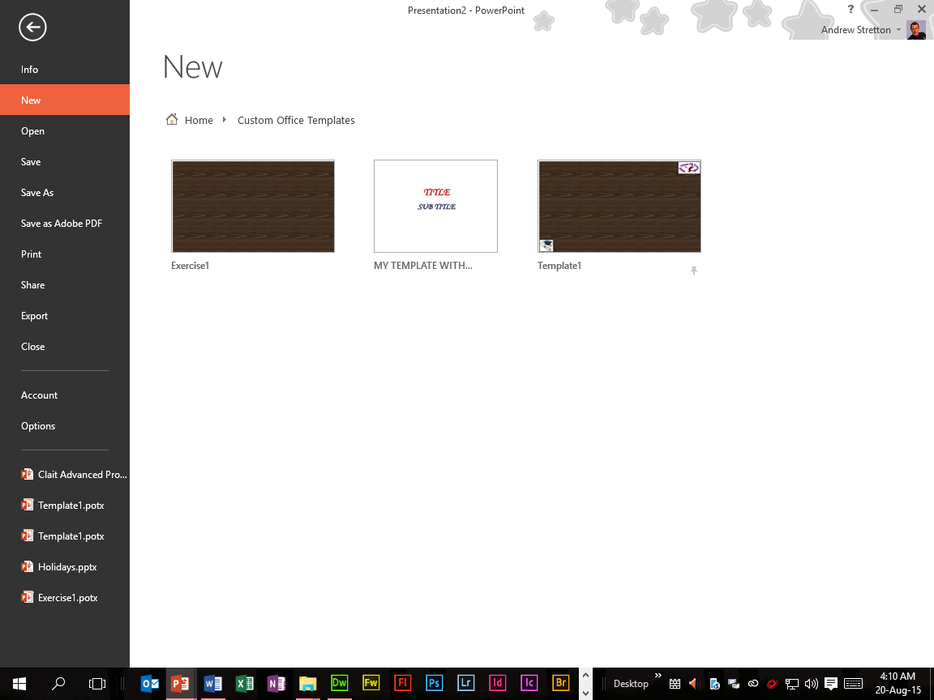
Section 1 Preparation Exercise 10 Using A Template
CS
Screen Print Evidence for 2b Objective of the Evidence Checklist:
Exercise1.potx Template Saved As and displayed in PowerPoint’s New Custom Office Templates.
(SECOND TEMPLATE
WITHIN SECTION 2)
Assessment
Checklist

Slide 14
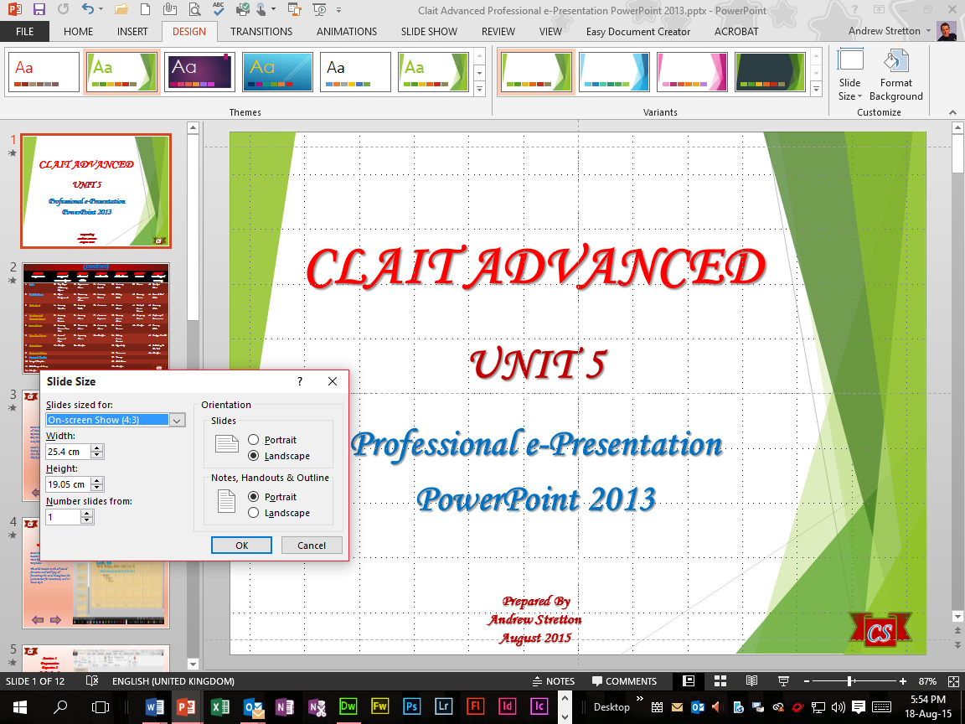
Section 1 Preparation Exercise 11 Slide Design & Setup
CS
Screen Print Evidence of:
Slide Design applied to my Clait Advanced Professional e-Presentation using a Facet Theme from the Themes Group.
On-Screen Show 4:3 display from the Slide Size Dialog Box.

Slide 15
Section 1 Assessment Checklist
CS
2 | Create and use complex style sheets and formatting techniques, creating and amending template documents for a variety of purposes | Slide Location
2a | Create or modify a Master Slide |  | √
 | A Title Slide Master |  | √
 | A Notes Page Master for the presentation |  | √
2b | Create at least 2 different templates (min 2) |  | √
 |  |  | √
2c | Create and use a variety of font styles (min 4) |  | √
 |  |  | √
 |  |  | √
2d | Save embedded fonts in presentation for styles |  | √
 |  |  | √
2e | Add custom or textured backgrounds |  | √
 |  |  | √
 |  |  | √
Click
Click
Click
Click
Click
Click
Click
Click
Click
Click
Click
Click
Click

Slide 16
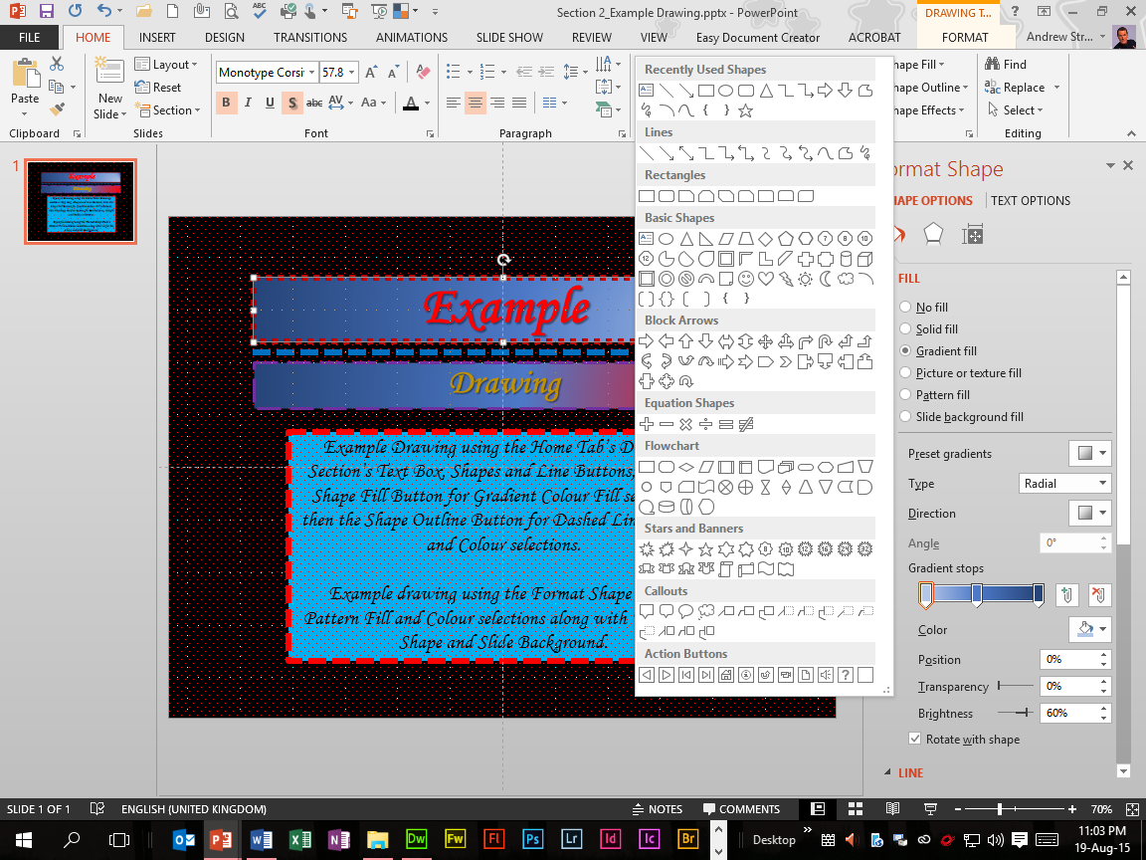
Section 2 Images & Drawn Objects Exercise 12 Text Boxes & Drawing Objects
CS
Screen Print Evidence of:
Example Drawing applied to my Section 2 Example Drawing Presentation from the Home Tab’s Drawing Section’s Text Boxes, Shapes and Line Buttons, then the Shape Fill Button for Gradient Colour Fill Selections, then the Shape Outline Button for Dashed Line, Weight and Colour Selections.

Slide 17
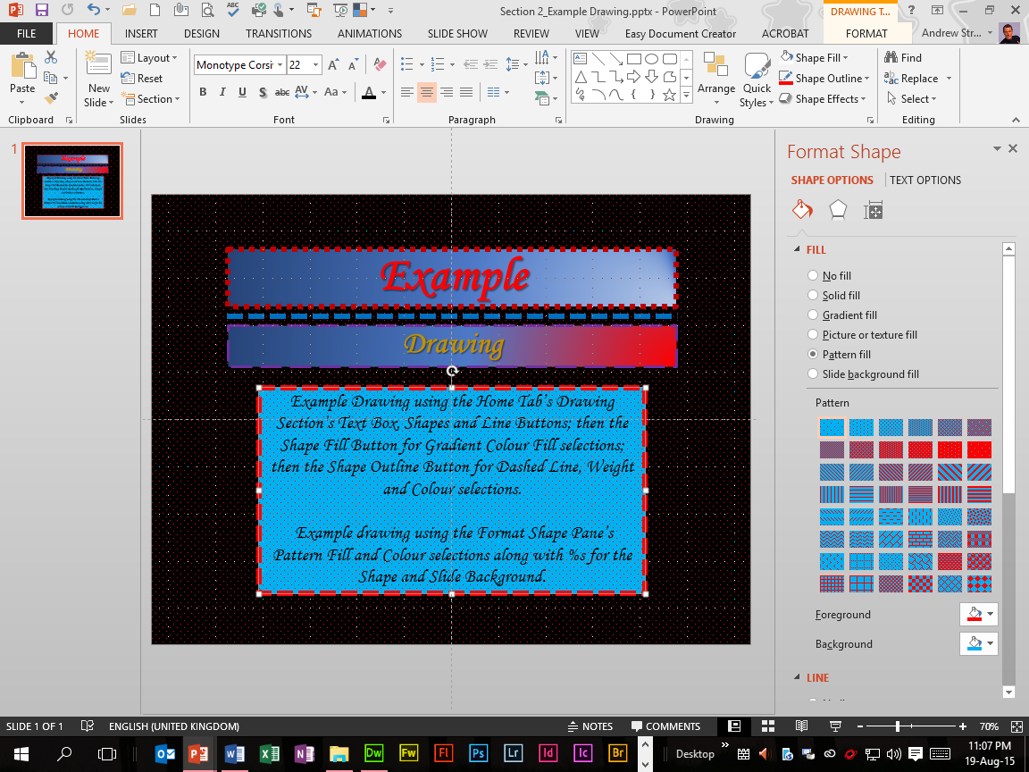
Section 2 Images & Drawn Objects Exercise 13 Object Backgrounds
CS
Screen Print Evidence of:
Example drawing applied to my Section 2 Example Drawing Presentation from the Format Shape Task Pane’s Pattern Fill and Colour Selections along with Colour Percentages for the Shading and Lines Shading.

Slide 18
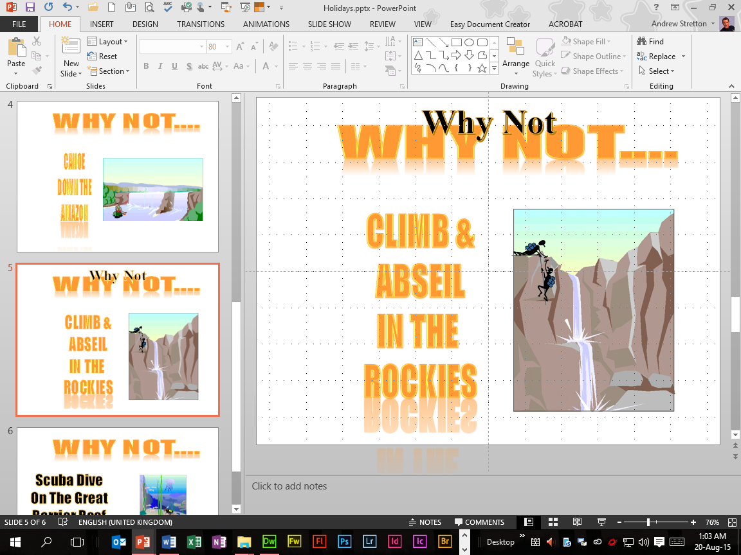
Section 2 Images & Drawn Objects Exercise 14 Inserting WordArt
CS
Screen Print Evidence of:
Inserted WordArt applied to the Holidays Presentation from the Insert Tab’s WordArt Button within the Text Section.

Slide 19
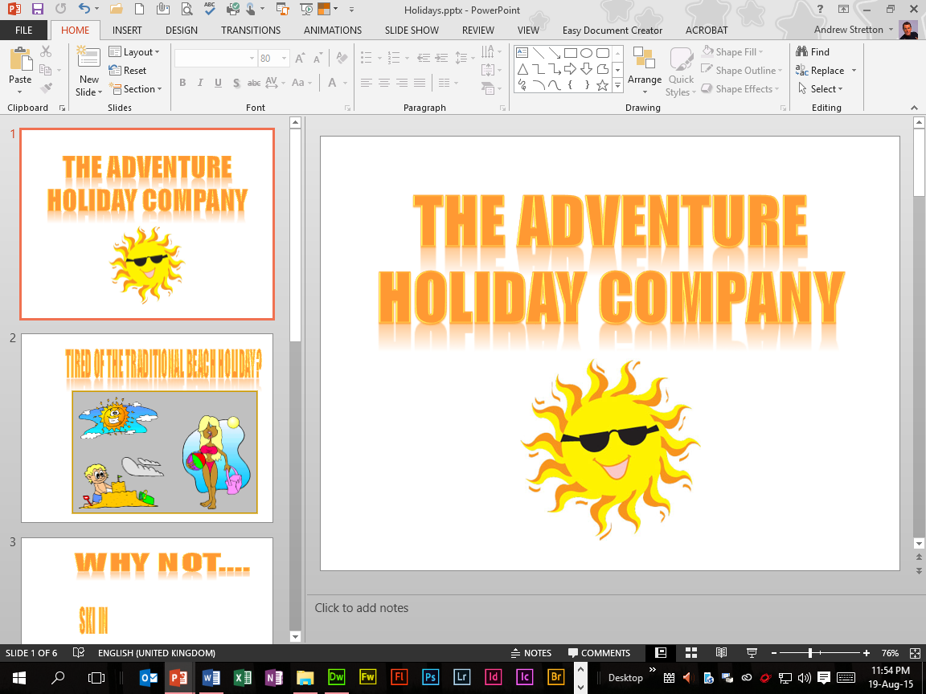
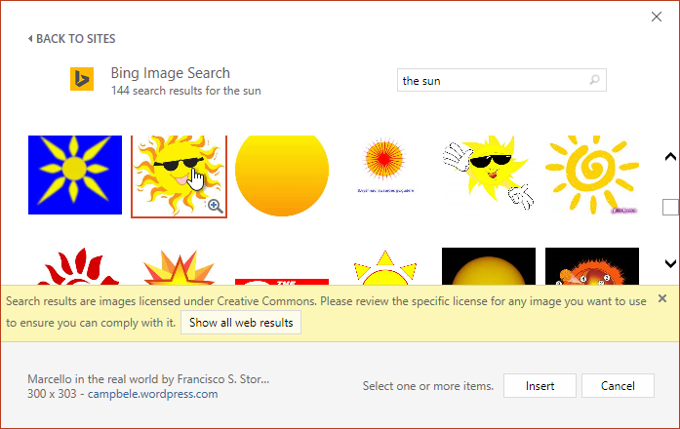
Section 2 Images & Drawn Objects Exercise 15 Inserting Online Pictures
CS
Screen Print Evidence of:
Inserted Online Picture applied to the Holidays Presentation from the Insert Tab’s Online Pictures Button within the Images Section.

Slide 20
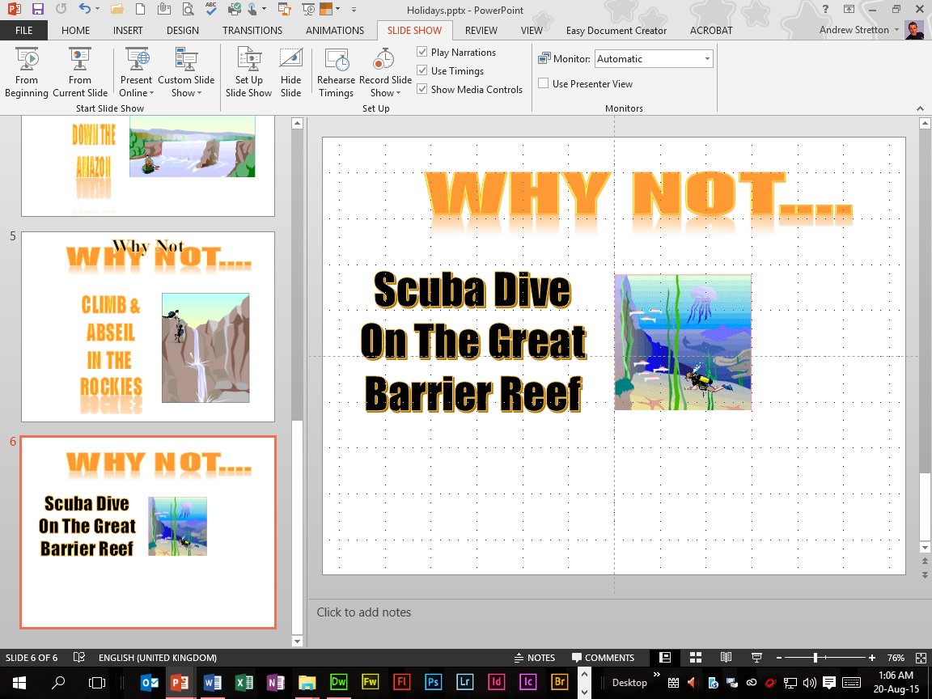
Section 2 Images & Drawn Objects Exercise 16 Inserting Pictures From File
CS
Screen Print Evidence of:
Inserted Picture applied to the Holidays Presentation from the Insert Tab’s Pictures Button within the Images Section.

Slide 21
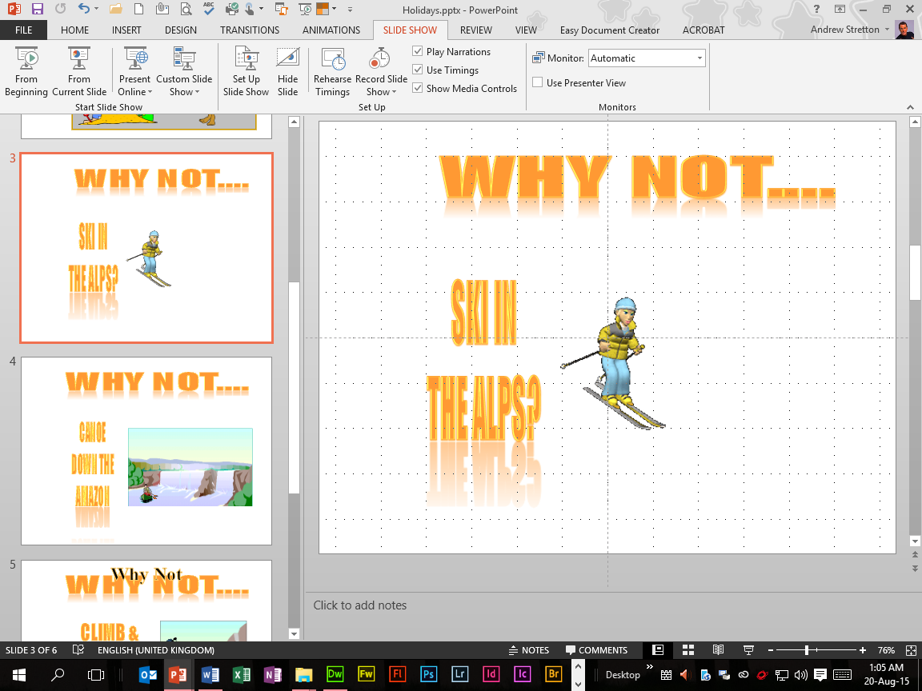
Section 2 Images & Drawn Objects Exercise 17 Inserting Animated Clips
CS
Screen Print Evidence of:
Inserted Animated GIF applied to the Holidays Presentation from the Insert Tab’s Pictures Button within the Images Section.

Slide 22
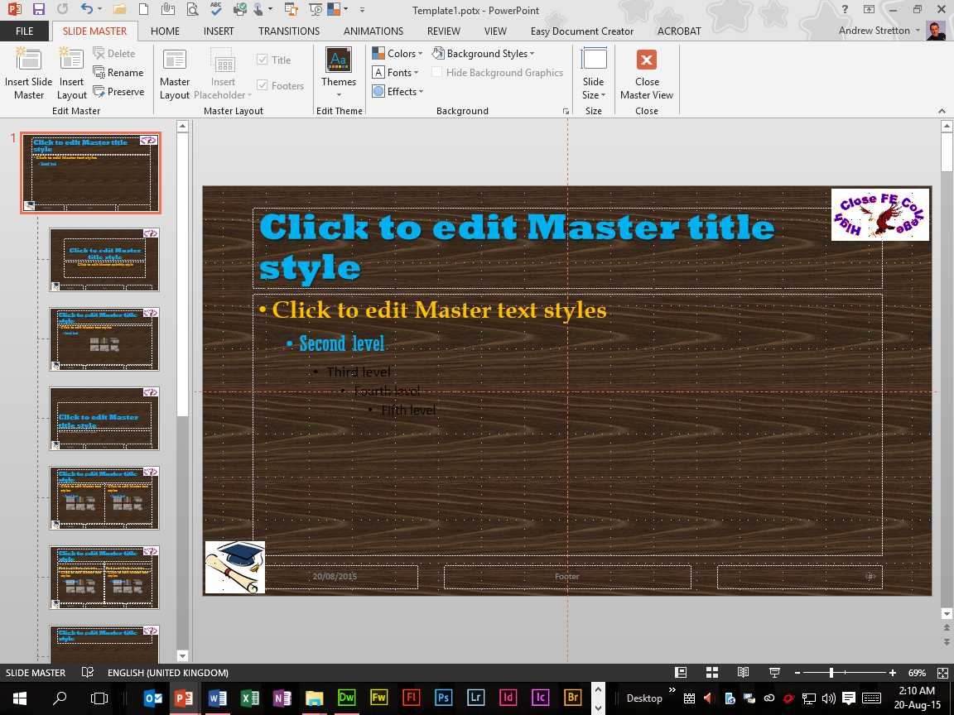
Section 2 Images & Drawn Objects Evidence Assessment 1
CS
Screen Print Evidence for 1m Objective of the Evidence Checklist:
Two GIFs (Top Right Corner and Bottom Left Corner) inserted to the Slide Master Template Template1 Presentation, Sized and Aligned accordingly.
Assessment
Checklist

Slide 23
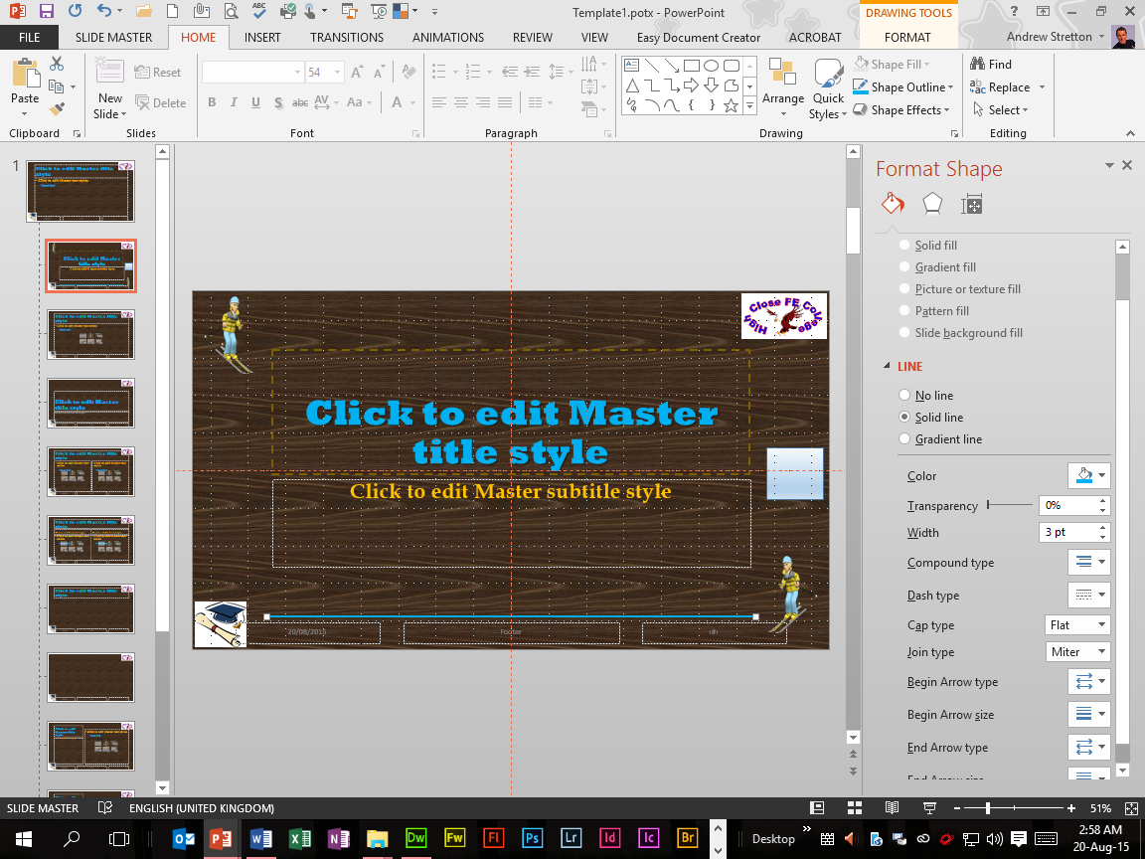
Section 2 Images & Drawn Objects Evidence Assessment 2
CS
Screen Print Evidence for 1n and 3d Objectives of the Evidence Checklist:
Text Box with Shading and Line Draw with Colour applied to Template1.potx Presentation.
Two Animated GIFs (Top Left Corner and Bottom Right Corner) inserted to the Title Slide Master Template1.potx Presentation, Sized and Aligned accordingly.
Assessment
Checklist

Slide 24
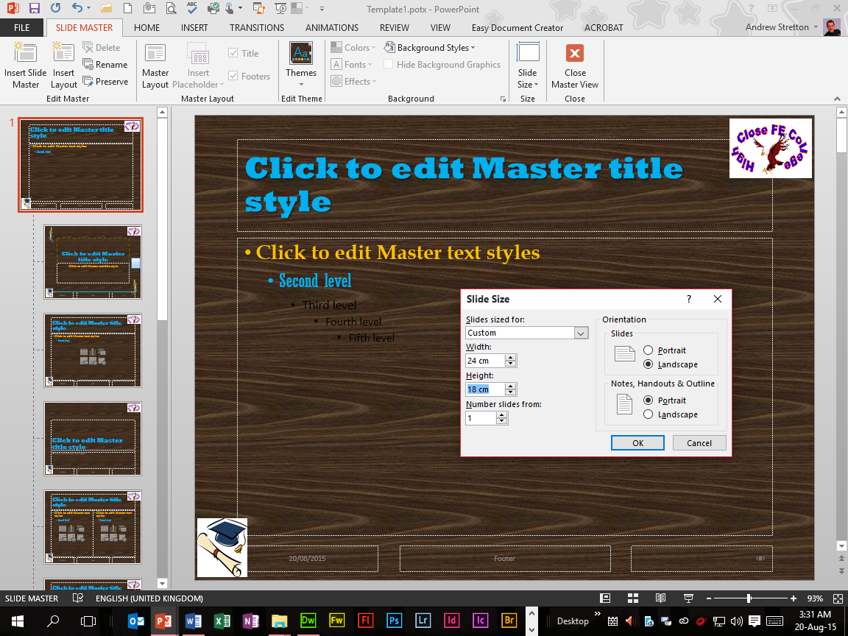
Section 2 Images & Drawn Objects Evidence Assessment 3
CS
Screen Print Evidence for 1l Objective of the Evidence Checklist:
Slide Master Template1.potx Presentation Slide Sizes applied along with Landscape and Portrait orientations.
Assessment
Checklist

Slide 25
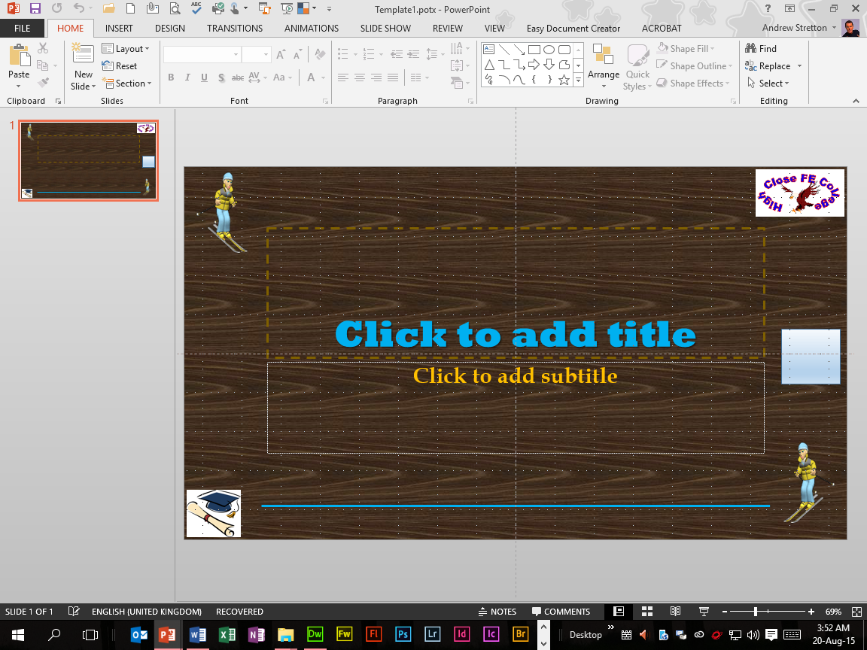
Section 2 Images & Drawn Objects Evidence Assessment 4
CS
Screen Print Evidence for 2b Objective of the Evidence Checklist:
Previous Exercise1.potx Template Saved As Template1.potx Template displayed in the Title Bar.
(FIRST TEMPLATE
WITHIN SECTION 1)
Assessment
Checklist

Slide 26

Section 2 Images & Drawn Objects Evidence Assessment 5
CS
Screen Print Evidence for 2b Objective of the Evidence Checklist:
Previous Exercise1.potx Template Saved As Template1.potx Template and displayed in PowerPoint’s New Custom Office Templates as Template1.
(FIRST TEMPLATE
WITHIN SECTION 1)
Assessment
Checklist

Slide 27
Section 2 Assessment Checklist
CS
2 | Create complex presentations | Slide Location
1l | Set page properties including orientation and output size |  | √
1m | Include a minimum of 2 images |  | √
1n | Include lines, boxes or shading |  | √
2 | Create and use complex style sheets and formatting techniques, creating and amending template documents for a variety of purposes
2b | Create at least 2 different templates (min 2) |  | √
 |  |  | √
3 | Use a range of visual effects
3d | Insert 2 animated GIFs |  | √
Click
Click
Click
Click
Click
Click

Slide 28
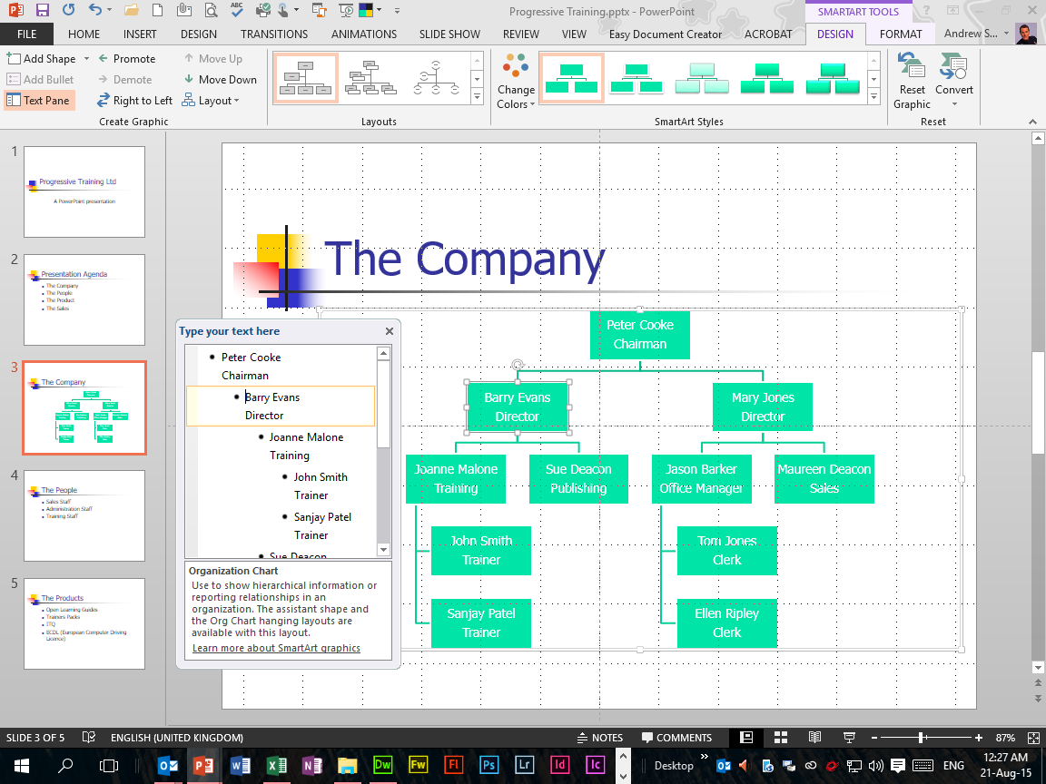
Section 3 Charts & Tables Exercise 18 Organisation Charts
CS
Screen Print Evidence of:
Inserted Organisation Chart applied to the Progressive Training Presentation from the Home Tab’s New Slide Button, then the Title and Content Slide Insert within the Slides Section.

Slide 29
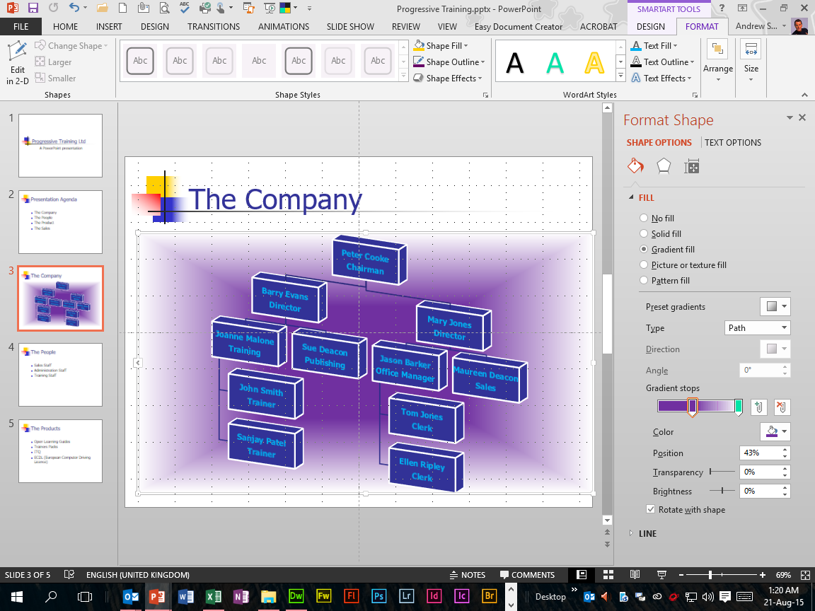
Section 3 Charts & Tables Exercise 19 Formatting Organisation Charts
CS
Screen Print Evidence for 3b Objective of the Evidence Checklist:
Inserted Organisation Chart applied to the Progressive Training Presentation from the Home Tab’s New Slide Button, then the Title and Content Slide Insert within the Slides Section, then formatted from the Design Tab’s SmartArt Styles Section and Layout Section, then enhanced using Gradient Fill, Preset Gradients and Gradient Stops from the Format Tab’s Shape Fill, Shape Outline and Shape Effects within the Shape Styles Section.
Assessment
Checklist

Slide 30
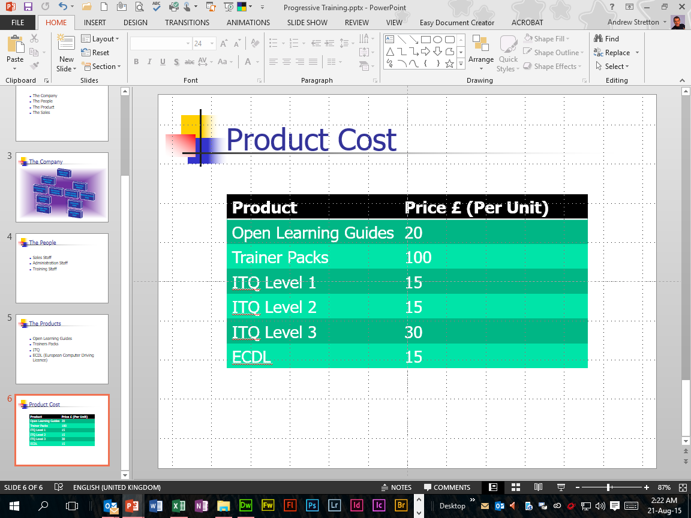
Section 3 Charts & Tables Exercise 20 Inserting Tables
CS
Screen Print Evidence of:
Inserted Table applied to the Progressive Training Presentation from the Home Tab’s New Slide Button, then the Title and Content Slide Insert within the Slides Section, then from the Tables Design Tab Selection a pre-designed Table layout applied from the Tables Styles Selection.
Table alignments applied using the Handles and Alignment Objects Button within the Layout Tab.

Slide 31
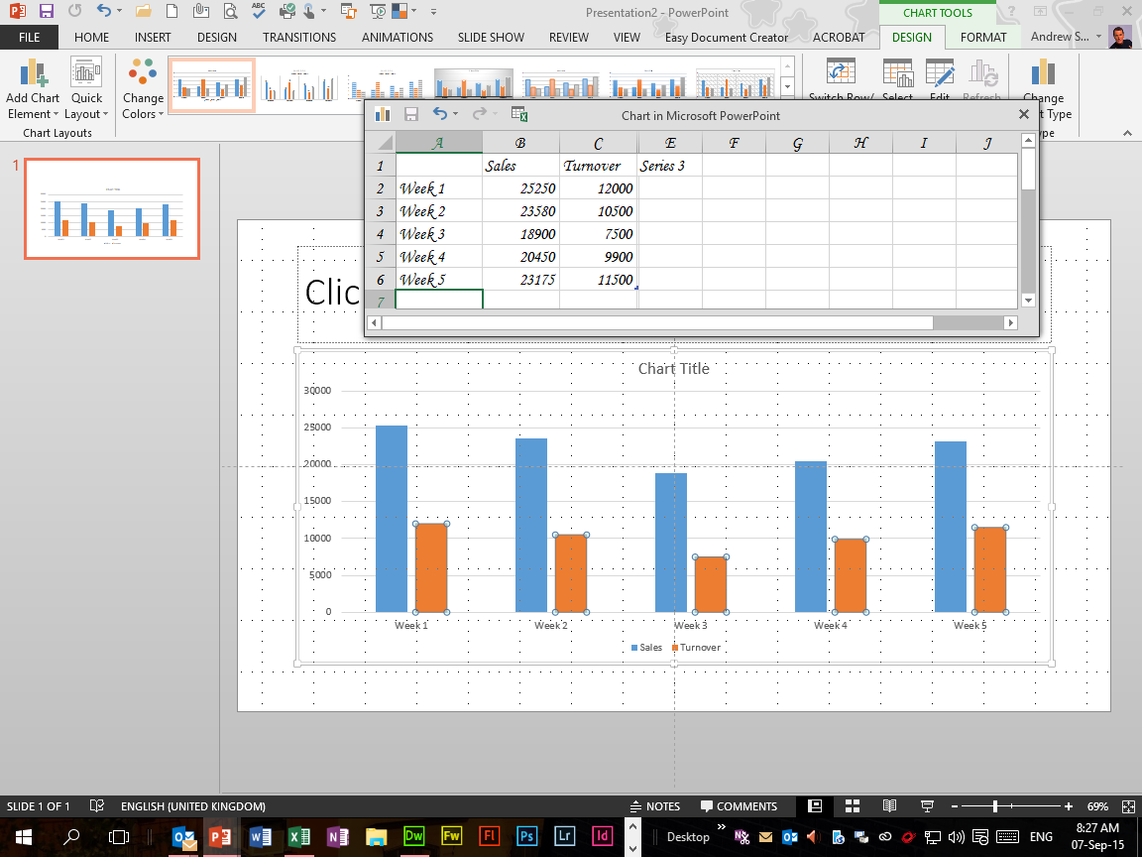
Section 3 Charts & Tables Exercise 21 Inserting Charts
CS
Screen Print Evidence of:
Inserted Column Chart applied to the Presentation2 Presentation from the Home Tab’s New Slide Button, then the Title and Content Slide Insert within the Slides Section.
Figures entered using Two Series.

Slide 32
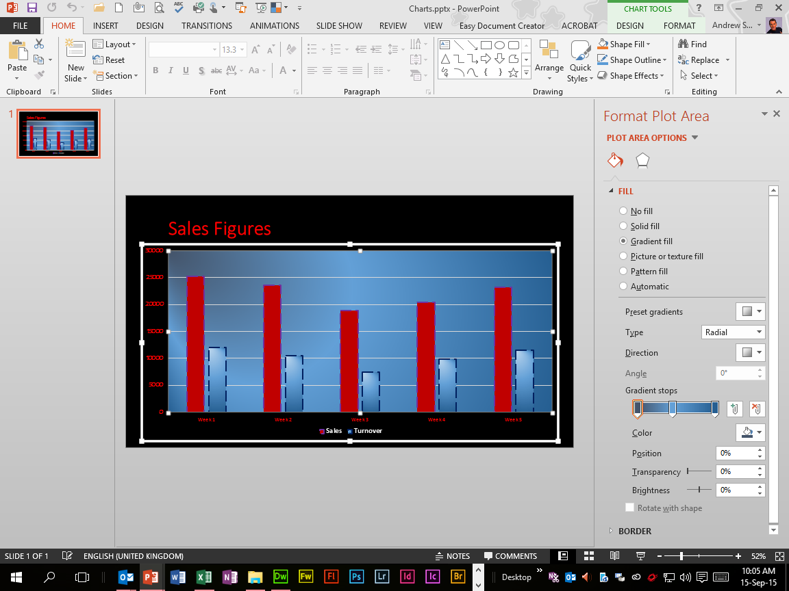
Section 3 Charts & Tables Exercise 22 Formatting Charts
CS
Screen Print Evidence of:
Inserted Column Chart applied to the Charts Presentation from the Home Tab’s New Slide Button, then the Title and Content Slide Insert within the Slides Section, then Formats applied from the Format Plot Area Task Pane.

Slide 33
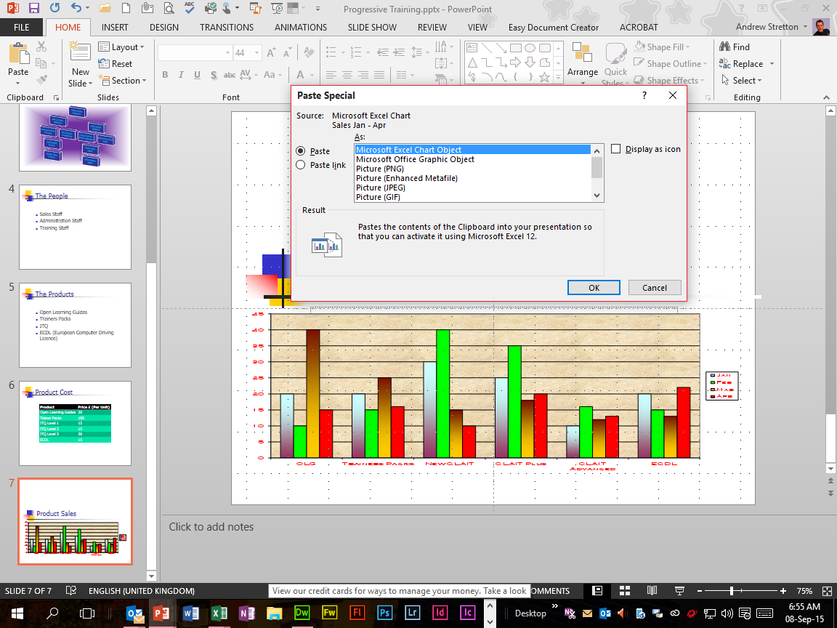
Section 3 Charts & Tables Exercise 23 Importing Charts
CS
Screen Print Evidence of:
Imported Column Chart to the Progressive Training Presentation from the Figures Spreadsheet using the Paste Special Dialog Box Function.

Slide 34
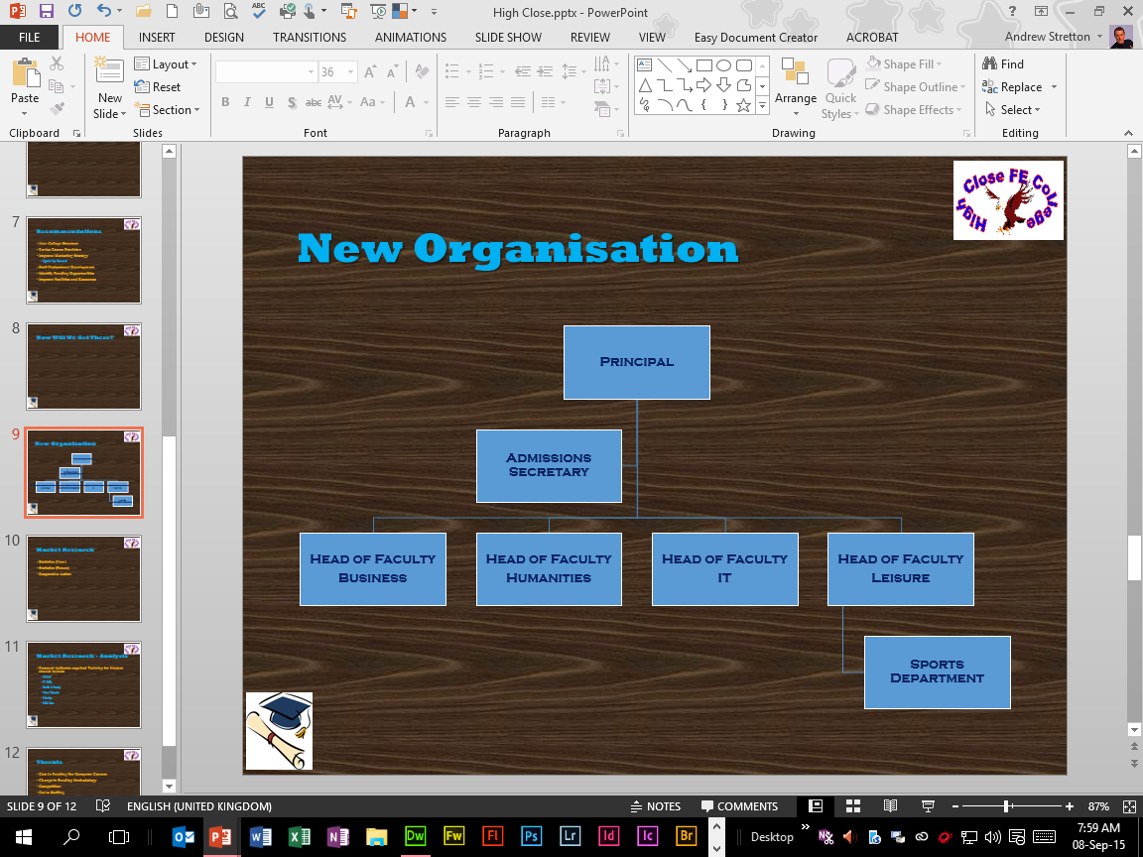
Section 3 Charts & Tables Evidence Assessment 6
CS
Screen Print Evidence for 3b Objective of the Evidence Checklist:
Inserted Organisation Chart applied to the High Close Presentation from the Home Tab’s New Slide Button, then the Title and Content Slide Insert within the Slides Section, then edited from the Add Shapes Button from the SmartArt Tools Tab.
Assessment
Checklist

Slide 35
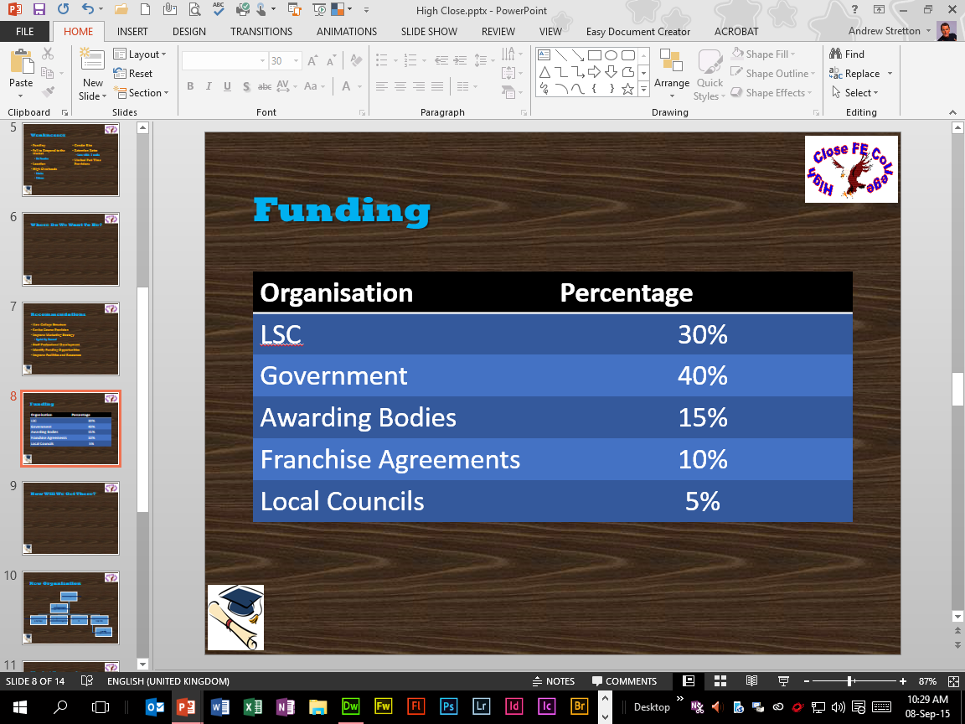
Section 3 Charts & Tables Evidence Assessment 7
CS
Screen Print Evidence for 3c Objective of the Evidence Checklist:
Inserted Table applied to the High Close Presentation from the Home Tab’s New Slide Button, then the Title and Content Slide Insert within the Slides Section. then from the Tables Design Tab Selection a pre-designed Table layout applied from the Tables Styles Selection.
Table alignments applied using Handles and Alignment Objects Button within the Layout Tab.
Assessment
Checklist

Slide 36
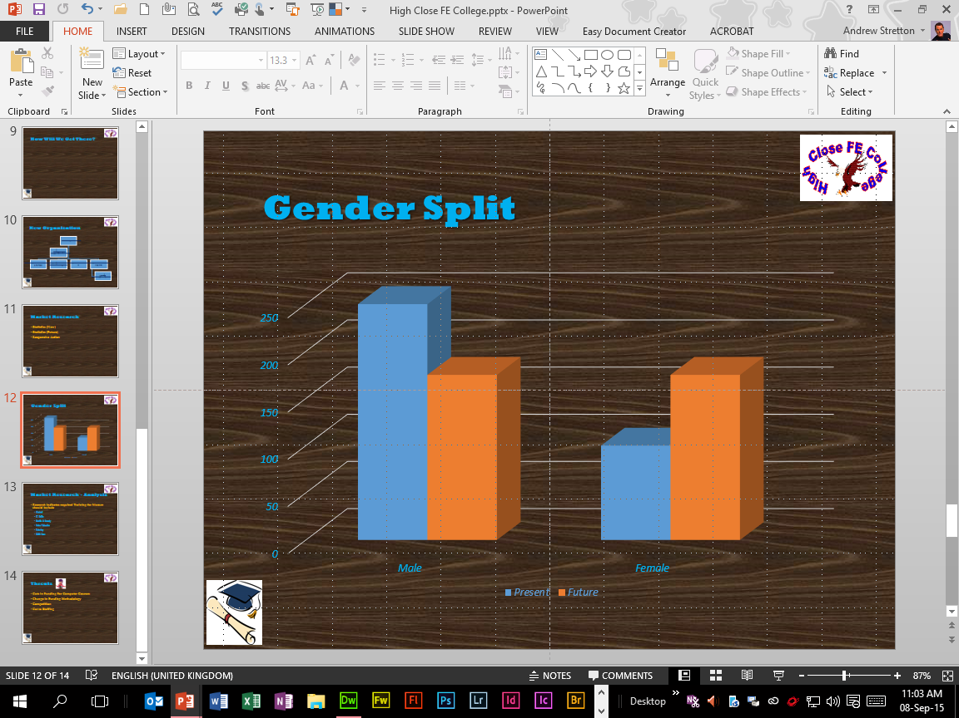
Section 3 Charts & Tables Evidence Assessment 8
CS
Screen Print Evidence for 3a Objective of the Evidence Checklist:
Inserted Column Chart applied to the High Close FE College Presentation from the Home Tab’s New Slide Button, then the Title and Content Slide Insert within the Slides Section, then Formats applied from the Design Tab’s Chart Styles Section and Change Colors Button.
A Legend, Axes and Gridlines Also applied.
Figures entered using Two Series.
Assessment
Checklist

Slide 37
Section 3 Assessment Checklist
CS
3 | Insert/create and modify presentations | Slide Location
3a | Insert/create, modify and format a graph/chart |  | √
3b | Create and format an organisation chart |  | √
3c | Insert/create and format a table |  | √
Click
Click
Click

Slide 38
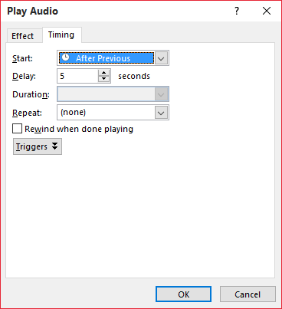
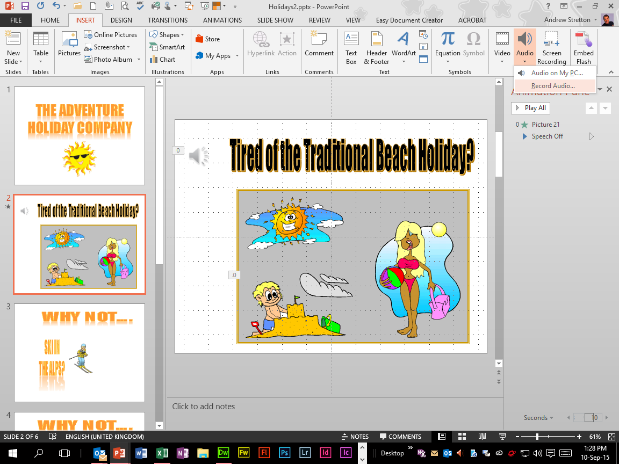
Section 4 Multimedia Exercise 24 Inserting Sounds
CS
Screen Print Evidence for 3g, 3h and 3i Objectives of the Evidence Checklist:
Inserted Sound File “Speech Off” applied to the Holidays2 Presentation from the Insert Tab’s Audio Button, then the Audio On My PC Selection within the Media Section.
Animation and a Sound delay of 5 seconds applied to bottom left picture on running Slide Show To Start On Click from the Slide Show Tab’s From Current Slide Button within the Start Slide Show Section.
Assessment
Checklist
Beach Holiday

Slide 39
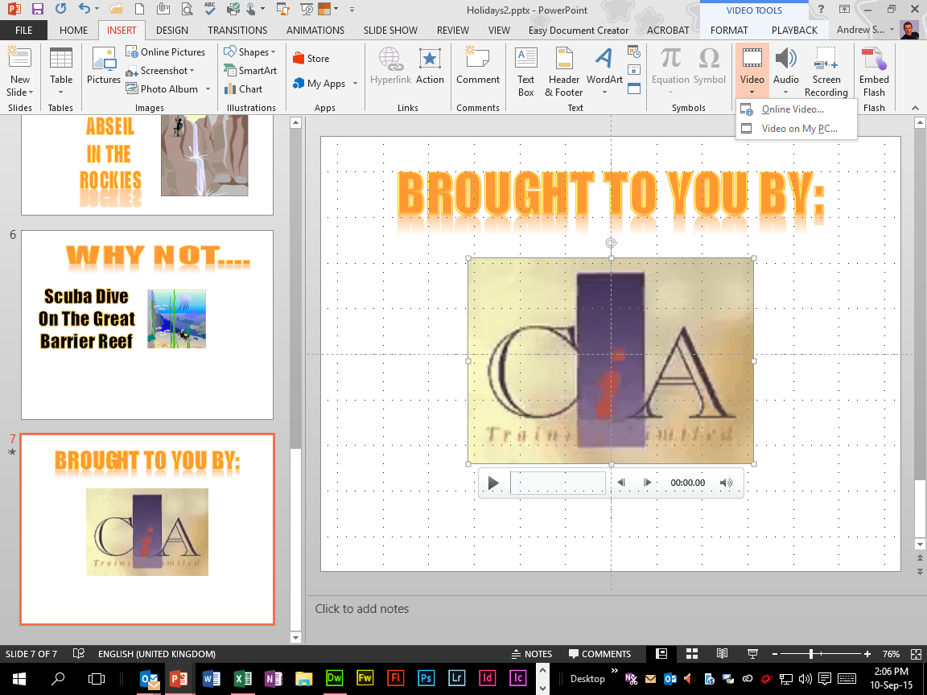
Section 4 Multimedia Exercise 25 Inserting Movies
CS
Screen Print Evidence of:
Inserted Video Clip applied to the Holidays2 Presentation from the Insert Tab’s Video Button, then Video On My PC Selection within the Media Section.
Video Clip played on running Slide Show on 2 Clicks from the Slide Show Tab’s From Current Slide Button within the Start Slide Show Section.
Brought To You
By Video Clip

Slide 40
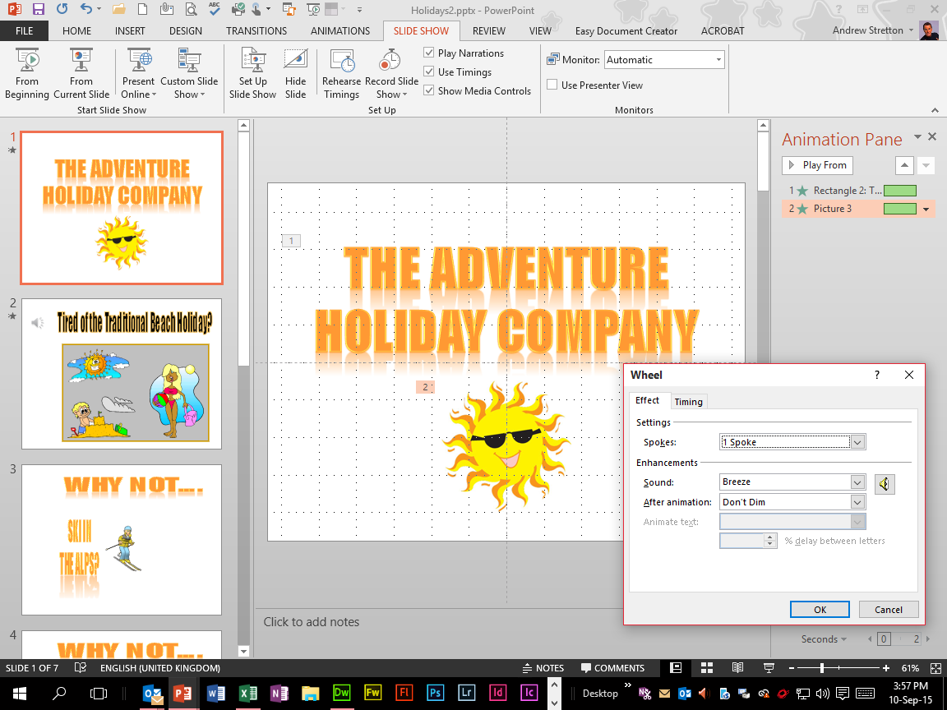
Section 4 Multimedia Exercise 26 Animation
CS
Screen Print Evidence for 5i Objective of the Evidence Checklist:
Animation Effect “Bounce” and Drum Role Sound applied to the Holidays2 Presentation’s Title Text To Start On Click from the Slide Show Tab’s From Current Slide Button within the Start Slide Show Section.
Animation Effect “Wheel” and Breeze Sound applied to the Picture to Start On Click.
The
Adventure Holiday
Company
Assessment
Checklist

Slide 41
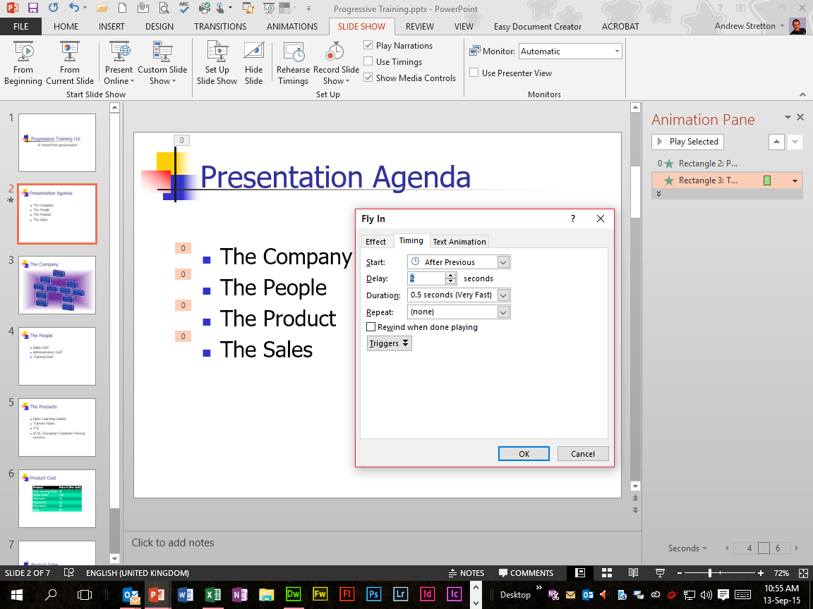
Section 4 Multimedia Exercise 27 Animation Sequences
CS
Screen Print Evidence for 3k Objective of the Evidence Checklist:
Animation Effect “Swivel” and then Red Colour Change applied to the Progressive Training Presentation to start After Previous applied to Title Text timed to Start After Previous on running Slide Show automatically from the Slide Show Tab’s From Current Slide Button within the Start Slide Show Section.
Animation Effect “Fly In” From Left and then Blue Colour Change to start After Animation applied to Bulleted List timed to Start After Previous By 1st Level Paragraphs with 2 seconds delay.
Presentation Agenda
Assessment
Checklist

Slide 42
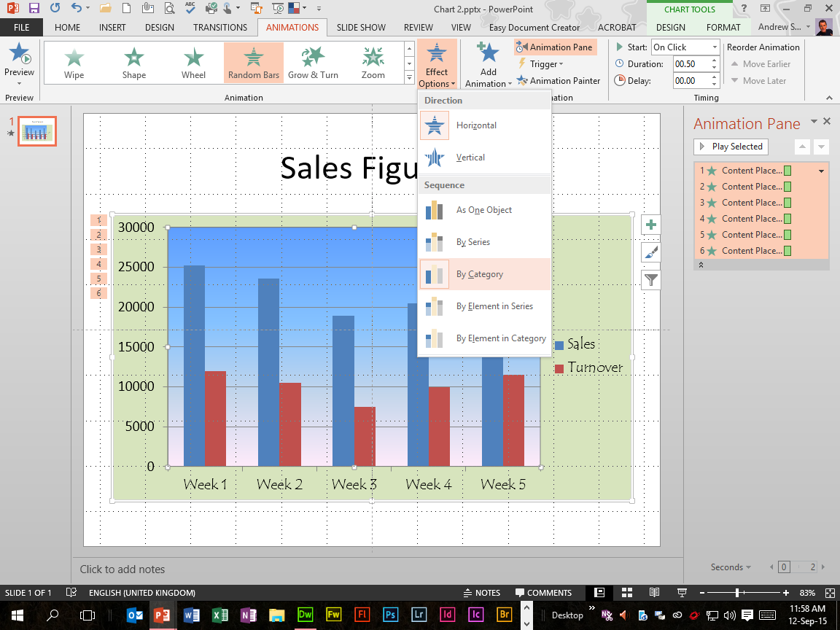
Section 4 Multimedia Exercise 28 Animating Charts
CS
Screen Print Evidence for 3f, 3i and 3k Objectives of the Evidence Checklist:
Animation Effect “Random Bars” applied to the Chart2 Presentation to display By Category From the Effects Options applied within the Animation Section on running Slide Show on each Click from the Slide Show Tab’s From Current Slide Button within the Start Slide Show Section.
Then changed to display By Element In Series on running Slide Show on each Click again.
Assessment
Checklist
Sales Figures

Slide 43
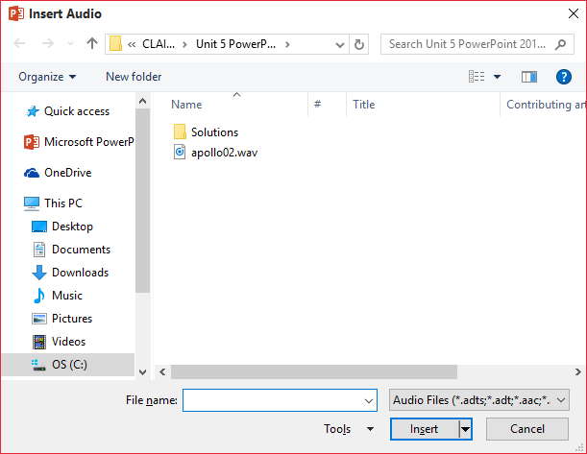
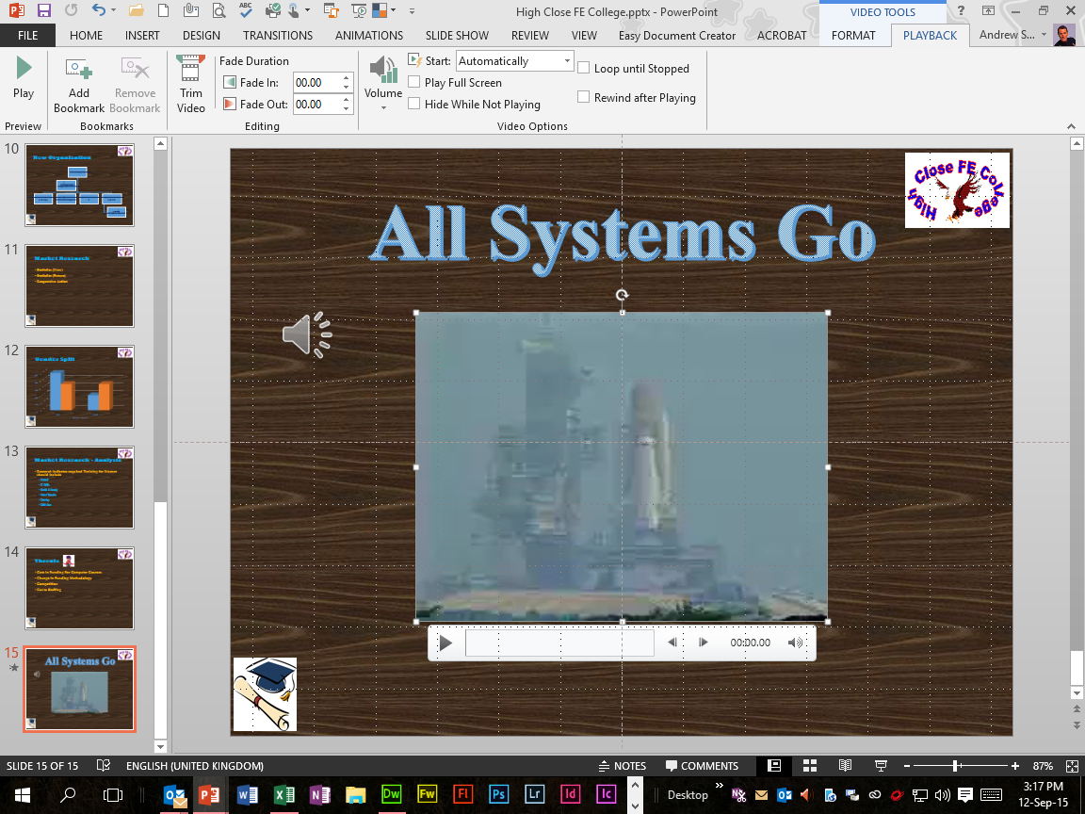
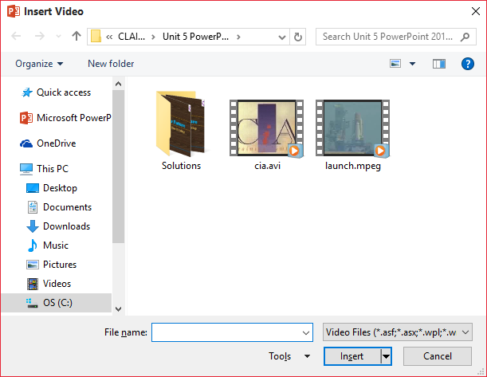
Section 4 Multimedia Evidence Assessment 9
CS
Screen Print Evidence for 3e Objective of the Evidence Checklist:
Inserted Video File applied to the High Close FE College Presentation from the Insert Tab’s Video Button, then Video On My PC Selection within the Media Section.
Inserted Sound File from the Insert Tab’s Audio Button, then Audio On My PC Selection within the Media Section.
All Systems Go
Assessment
Checklist

Slide 44
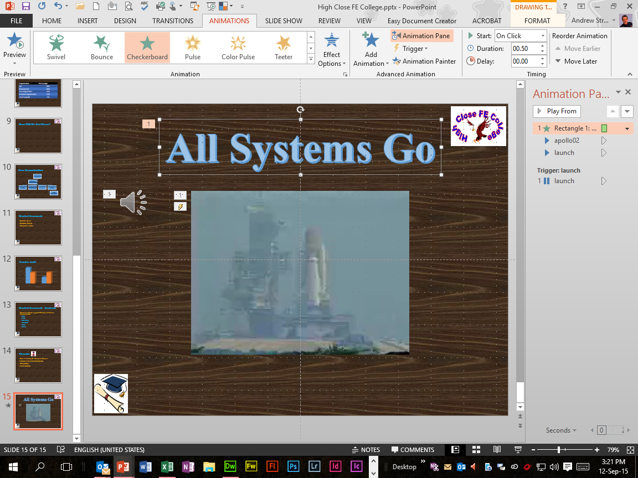
Section 4 Multimedia Evidence Assessment 10
CS
Screen Print Evidence for 3f, 3i, 3k and 5i Objectives of the Evidence Checklist:
Animation Effect “Checkerboard” applied to the High Close FE College Presentation’s Title Text To Start On Click from the Slide Show Tab’s From Current Slide Button within the Start Slide Show Section.
Sound File to start Automatically With Previous.
Video File to also start Automatically With Previous.
Assessment
Checklist
All Systems Go

Slide 45
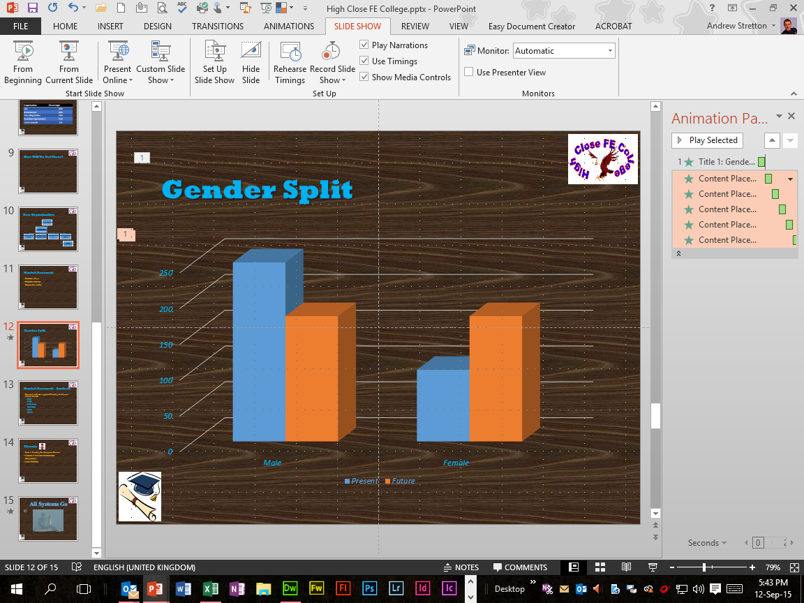
Section 4 Multimedia Evidence Assessment 11
CS
Screen Print Evidence for 3g, 3h and 3i Objectives of the Evidence Checklist:
Animation Effect “Strips” with Builds Direction Right Down applied to the High Close FE College Presentation, then Sound Drum Roll applied to Title Text To Start On Click from the Slide Show Tab’s From Current Slide Button within the Start Slide Show Section.
Animation Effect “Split” with Builds Direction Horizontal In and animation By Element In Series then applied to Column Chart To Start On Click.
Assessment
Checklist
Gender Spit

Slide 46
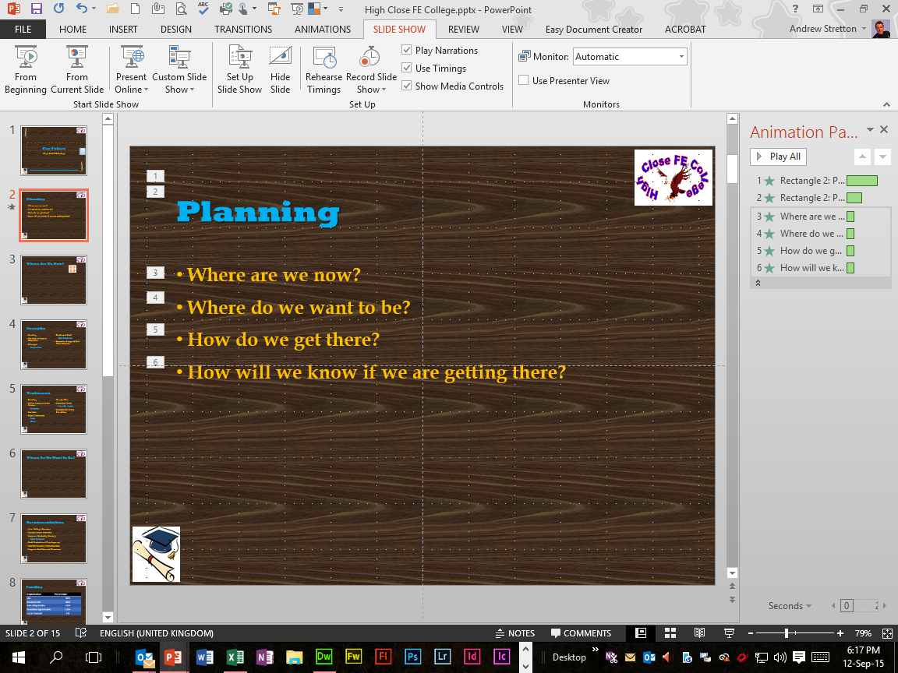
Section 4 Multimedia Evidence Assessment 12
CS
Screen Print Evidence for 3f and 3i Objectives of the Evidence Checklist:
Animation Effect “Wheel” then “Grow & Turn” applied to the High Close FE College Presentation, then Dark Blue Colour Change to start After Animation applied to Title Text To Start After Previous from the Slide Show Tab’s From Current Slide Button within the Start Slide Show Section.
Animation Effect “Fly In” From Left, then Red Colour Change to start After Previous applied to Bulleted List.
Assessment
Checklist
Planning

Slide 47
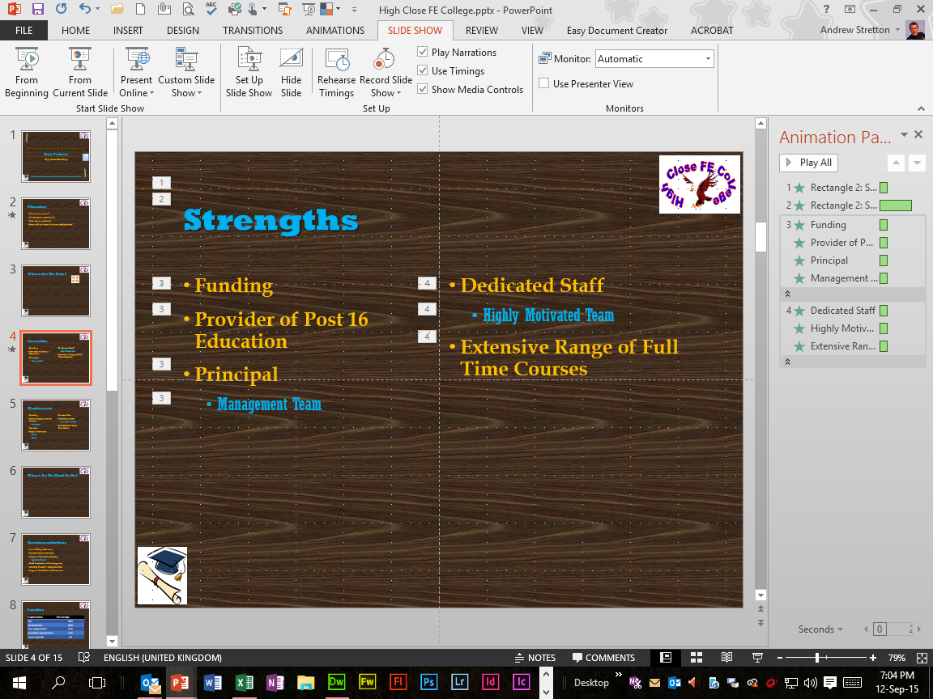
Section 4 Multimedia Evidence Assessment 13
CS
Screen Print Evidence for 3f and 3i Objectives of the Evidence Checklist:
Animation Effects “Random Bars” then “Swivel” applied to the High Close FE College Presentation, then Red Colour Change to start After Animation applied to Title Text To Start After Previous from the Slide Show Tab’s From Current Slide Button within the Start Slide Show Section.
Animation Effect “Fly In” From Left for the left Bulleted List, then “Fly In” From Right for the Right Bulleted List To Start After Previous.
Assessment
Checklist
Strengths

Slide 48
Section 4 Assessment Checklist
CS
3 | Use a range of visual and audio effects | Slide Location
3e | Import audio or video clip(s) |  | √
3f | Use a minimum of 3 slide animations
 |  |  | √
 |  |  | √
 |  |  | √
3g | 2 sounds and 2 animations of slide items |  | √
 |  |  | √
3h | Animate a graph/chart |  | √
3i | Use animation facilities |  | √
 |  |  | √
3k | Apply timings |  | √
5 | Save, print and produce support materials for a presentation
5i | Print a screen print(s) to evidence the following:
 | Animations |  | √
 | Timings |  | √
Click
Click
Click
Click
Click
Click
Click
Click
Click
Click
Click
Click

Slide 49
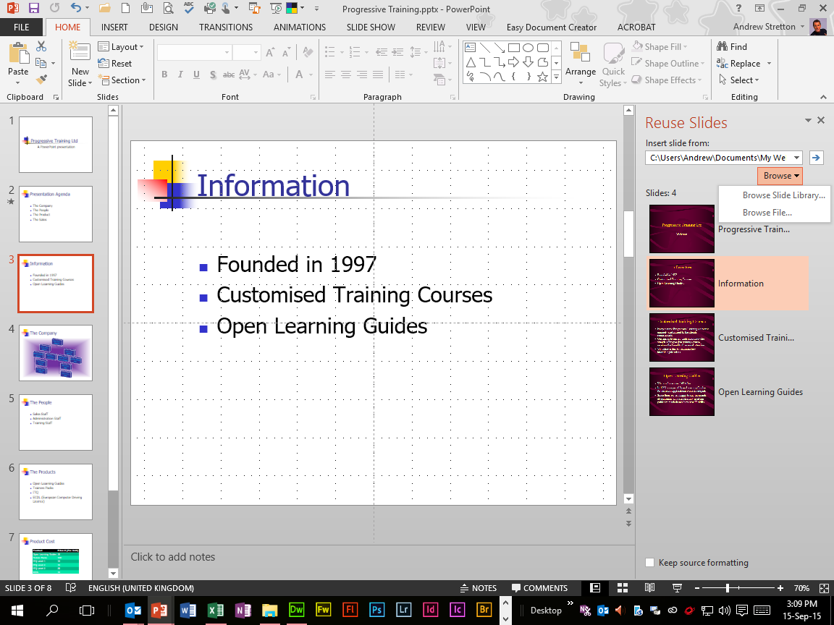
Section 5 Slide Shows Exercise 29 Inserting Slides
CS
Screen Print Evidence of:
Inserted Slide from the Company Presentation to the Progressive Training Presentation from the Home Tab’s New Slide Button, then the Re-Use Slides Selection within the Slides Section.
Then the Browse File Selection within the Browse Button within the Reuse Slides Pane, then Keep Source Formatting Un-Ticked when Slide is Inserted for appropriate formatting.

Slide 50
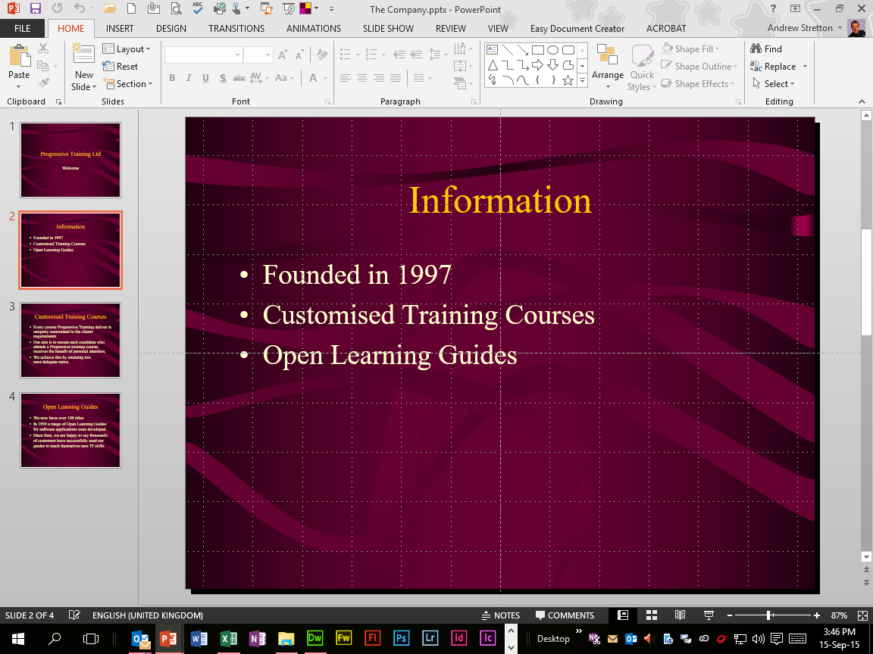
Section 5 Slide Shows Exercise 29a Inserted Slide 1
CS
Screen Print Evidence of:
Inserted Slide from The Company Presentation to the Progressive Training Presentation.

Slide 51
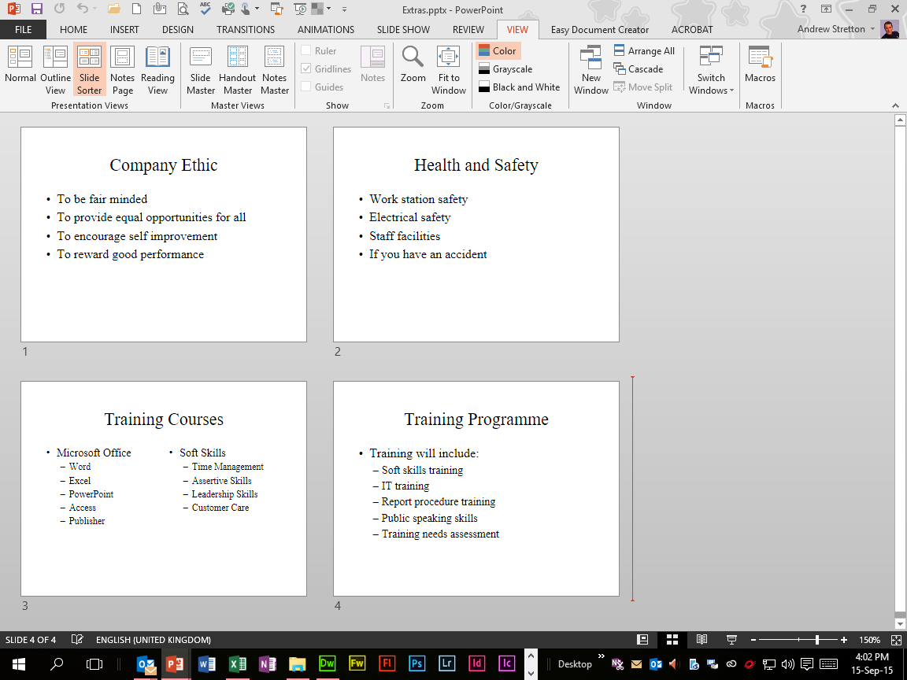
Section 5 Slide Shows Exercise 29b Inserted Slides 2
CS
Screen Print Evidence of:
Inserted Slides from the Extras Presentation to the Progressive Training Presentation.

Slide 52
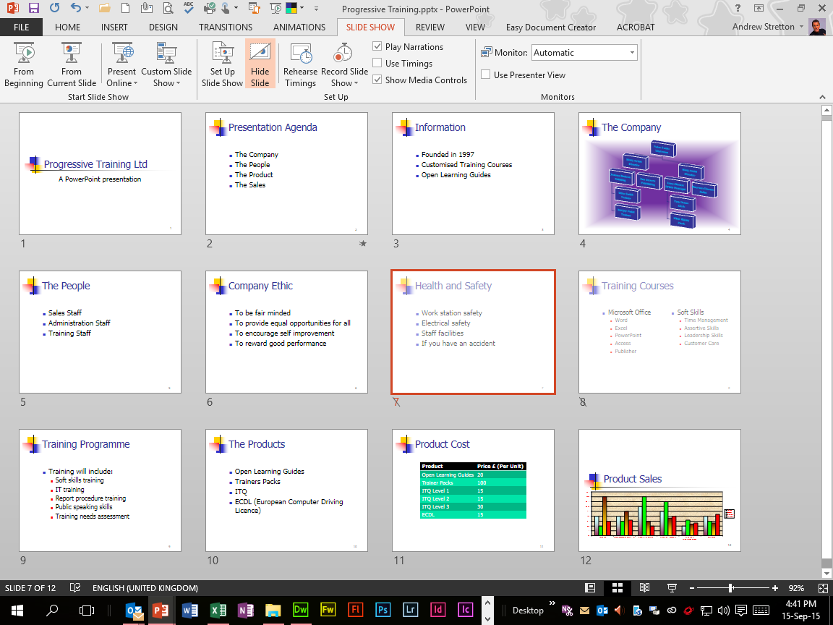
Section 5 Slide Shows Exercise 30 Hiding Slides
CS
Screen Print Evidence for 1e Objective of the Evidence Checklist:
Slides 7 and 8 of the Progressive Training Presentation Hidden from the Slide Show Tab’s Hide Slide Button within the Set Up Section.
Assessment
Checklist

Slide 53
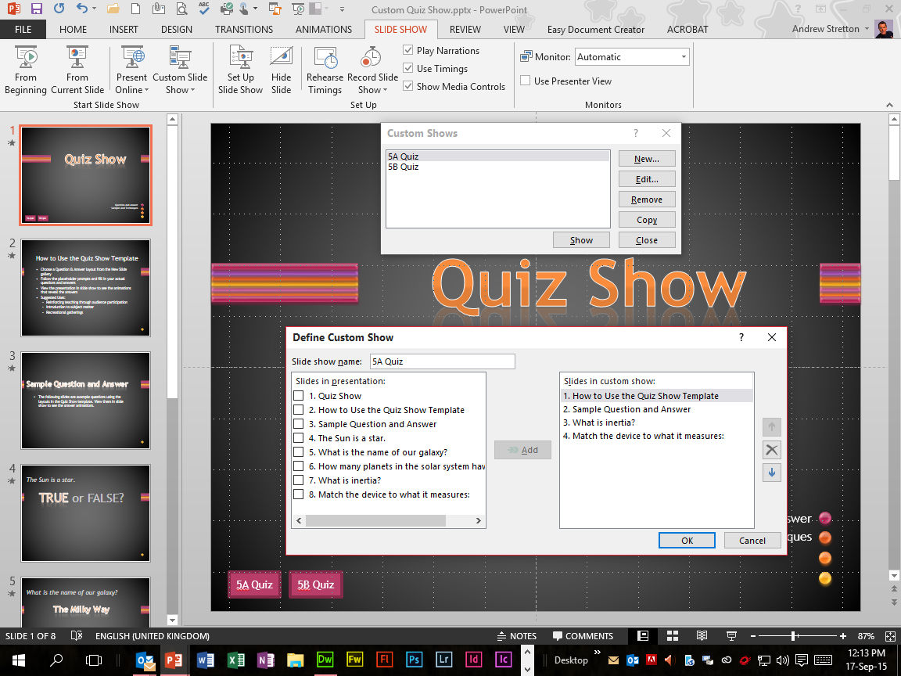
Section 5 Slide Shows Exercise 31 Custom Shows
CS
Screen Print Evidence of:
Two Custom Slide Shows applied, i.e. 5A Quiz and 5B Quiz to the Custom Quiz Show Presentation from the Slide Show Tab’s Custom Slide Show Button, then the Custom Shows Dialog Box, then the New Button, then select the required Slides within the Slides In Presentation Selection within the Define Custom Show Dialog Box, then select Add, then select OK, then select Show for either 5A or 5B Quiz within the Custom Shows Dialog Box.

Slide 54
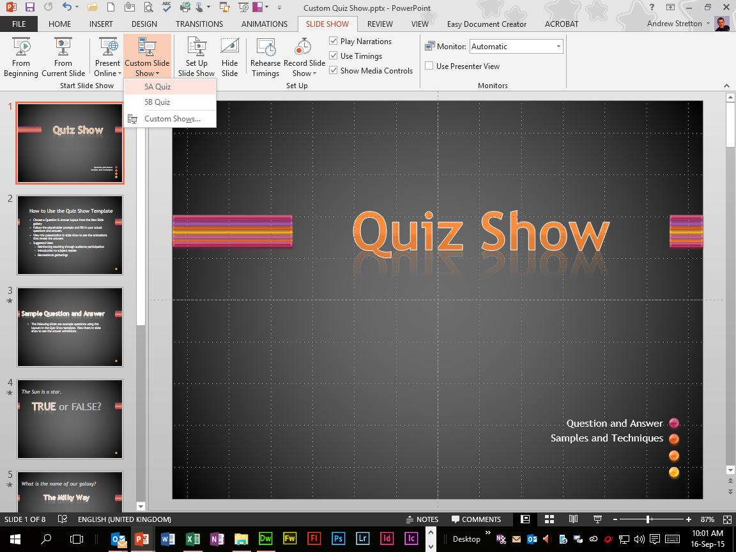
Section 5 Slide Shows Exercise 32 Running Custom Shows
CS
Screen Print Evidence of:
5A Quiz and 5B Quiz Custom Slide Shows within the Custom Quiz Show Presentation to be Run from the Slide Show Tab’s Custom Slide Show Button within the Start Slide Show Section.

Slide 55
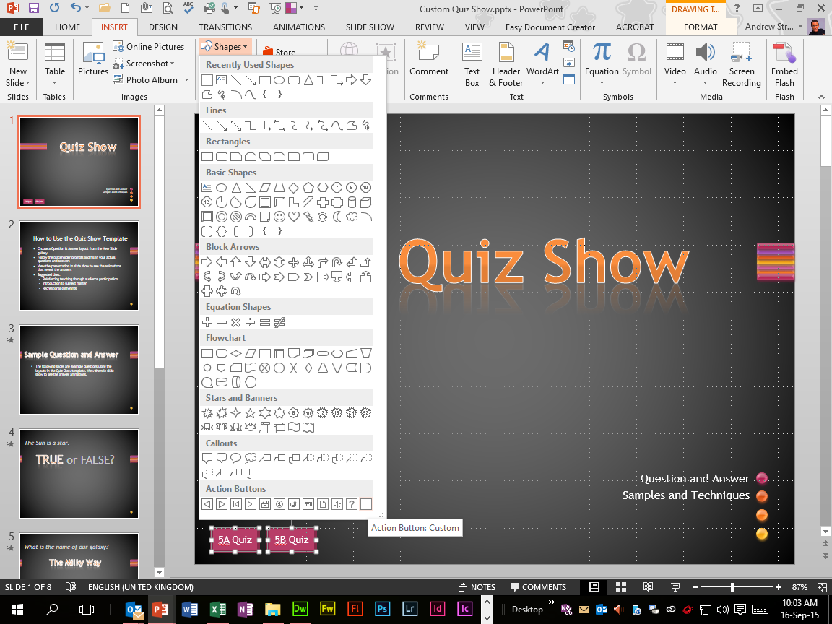
Section 5 Slide Shows Exercise 33 Action Buttons
CS
Screen Print Evidence of:
Two Custom Action Buttons applied to the Custom Quiz Show Presentation’s Title Slide, i.e. 5A Quiz and 5B Quiz from the Insert Tab’s Shapes Button within the Illustrations Section.

Slide 56


Section 5 Slide Shows Exercise 33a Action Buttons 1
CS
Screen Print Evidence for 5i Objective of the Evidence Checklist:
Action Button 5A Quiz Link applied to the Custom Quiz Show Presentation from the Custom Show Dialog Box within the Hyperlink To Selection within the Action On Click Section within the Action Settings Dialog Box to Run Slide Show using the F5 Function Key.
Custom Quiz Show Click Transition
Assessment
Checklist

Slide 57


Section 5 Slide Shows Exercise 33b Action Buttons 2
CS
Screen Print Evidence for 3g & 5i Objectives of the Evidence Checklist:
Action Button 5B Quiz Link applied to the Custom Quiz Show Presentation from the Custom Show Dialog Box within the Hyperlink To Selection within the Action On Click Section within the Action Settings Dialog Box to Run Slide Show using the F5 Function Key.
Custom Quiz Show Timed Transition
Assessment
Checklist

Slide 58

Section 5 Slide Shows Exercise 34 Editing Action Buttons
CS
Screen Print Evidence for 1c Objective of the Evidence Checklist:
Action Button “Information” applied to Slide 4 of the IT Training1 Presentation from the Insert Tab’s Shapes Button within the Illustrations Section, then Linked to Slide 7 within the Hyperlink To Selection, then the Hyperlink To Slide Dialog Box within the Action Settings Dialog Box.
Assessment
Checklist

Slide 59

Section 5 Slide Shows Exercise 34a Editing Action Buttons 1
CS
Screen Print Evidence for 1c Objective of the Evidence Checklist:
Action Button “Back Or Previous” applied to Slide 7 of the IT Training1 Presentation from the Insert Tab’s Shapes Button within the Illustrations Section, then Linked to Slide 4 from the Hyperlink To Selection, then the Hyperlink To Slide Dialog Box within the Action Settings Dialog.
Assessment
Checklist

Slide 60

Section 5 Slide Shows Exercise 35 Hyperlinks In Slides
CS
Screen Print Evidence of:
Mailto: info@ciatraining.co.uk Copied from the IT Training1 Presentation, then to the Insert Tab’s Hyperlink Button, then the E-Mail Address Button, then Pasted to the E-Mail Address Selection within the Insert Hyperlink Dialog Box.
Assessment
Checklist

Slide 61

Section 5 Slide Shows Exercise 35a Hyperlinks In Slides 1
CS
Screen Print Evidence of:
E-Mail message to be sent to the Mailto Addressee using Outlook.

Slide 62

Section 5 Slide Shows Exercise 36 Applying Transitions
CS
Screen Print Evidence of:
Transition “Glitter” applied to All Slides within the Custom Quiz Show Presentation from the Transitions Tab’s Transition To This Slide Section, then a duration of 5 Seconds from the Duration Selection, then a time delay of 5 seconds after each Slide using the After Selection within the Advance Slide Section, then Apply To All Button within the Timing Section to Run Slide Show automatically using the F5 Function Key as shown on the next Slide.

Slide 63
Section 5 Slide Shows Exercise 37 Applying Timings
CS
Screen Print Evidence of:
Looped Slide Show Timings applied to the Custom Quiz Show Presentation from the Slide Show Tab’s Rehearse Timings Button, then Browse At A Kiosk (Full Screen) Selection from the Set Up Slide Show Button from the Set Up Section to Run Slide Show automatically using the F5 Function Key and then the Full Screen Function from the Status Bar Menu.
Custom Quiz Show

Slide 64


Section 5 Slide Shows Exercise 38 Slide Shows
CS
Screen Print Evidence of:
Manual Slide Show Timings applied to the Holidays2 Presentation from the Slide Show Tab’s Set Up Slide Show Button, then Presented By A Speaker (Full Screen) Selection within the Show Type Section, then the Manually Selection within the Advance Slides Section within the Set Up Show Dialog Box, then Show Media Controls Selection within the Set Up Section to Run Slide Show using the F5 Function Key, or by Clicking the Picture below.

Slide 65

Section 5 Slide Shows Evidence Assessment 14
CS
Screen Print Evidence for 1g Objective of the Evidence Checklist:
3 Slides Inserted from the General Information Presentation to the High Close FE College Presentation from the Home Tab’s New Slide Button within the Slides Section, then the Reuse Slides Selection and Browse Button’s Browse File Selection within the Reuse Slides Task Pane with Keep Source Formatting Un-Ticked.
Assessment
Checklist

Slide 66

Section 5 Slide Shows Evidence Assessment 14a
CS
Screen Print Evidence for 1a Objective of the Evidence Checklist:
18 Slides from the High Close FE College Presentation, which have had various functions applied, i.e. Insertion of Organisation Chart, Table, Column Chart, Video File, Sound File, Animations, Sounds, Timings, Pictures, Action Buttons, Hyperlinks, etc.
Assessment
Checklist

Slide 67

Section 5 Slide Shows Evidence Assessment 15
CS
Screen Print Evidence for 1b & 1f Objectives of the Evidence Checklist:
Custom Slide Show “Brief” applied to the High Close FE College Presentation from the Slide Show Tab’s Custom Slide Show Button, then the Custom Slide Show Dialog Box, then the New Button, then select the Slides within the Slides In Presentation Selection within the Define Custom Show Dialog Box within the Start Slide Show Section, then Run as displayed within the next Slide.
Assessment
Checklist

Slide 68






Section 5 Slide Shows Evidence Assessment 15a
CS
Screen Print Evidence for 1b & 1f Objectives of the Evidence Checklist:
Custom Slide Show “Brief” Run from within the High Close FE College Presentation from the Slide Show Tab’s Custom Slide Show Button within the Start Slide Show Section.
Custom Slide Show “Brief” applied within the previous Slide.
Custom Slide Show “Brief”
Assessment
Checklist

Slide 69


Section 5 Slide Shows Evidence Assessment 16
CS
Screen Print Evidence for 1d and 1h Objectives of the Evidence Checklist:
Titled Custom Action Button “Business” applied to Slide 13 of the High Close FE College Presentation from the Insert Tab’s Shapes Button, then Linked to Slide 1 of the Business Faculty File from the Hyperlink To Other File Dialog Box within the Hyperlink To Selection within the Action On Click Section within the Actions Settings Dialog Box within the Illustrations Section.
Business
Assessment
Checklist

Slide 70


Section 5 Slide Shows Evidence Assessment 17
CS
Screen Print Evidence for 1d and 1h Objectives of the Evidence Checklist:
Titled Custom Action Button “IT” applied to Slide 13 of the High Close FE College Presentation from the Insert Tab’s Shapes Button, then Linked to Slide 1 of the IT Faculty File from the Hyperlink To Other File Dialog Box within the Hyperlink To Selection within the Action On Click Section within the Actions Settings Dialog Box within the Illustrations Section.
IT
Assessment
Checklist

Slide 71

Section 5 Slide Shows Evidence Assessment 18
CS
Screen Print Evidence for 1i Objective of the Evidence Checklist:
URL: www.dfes.gov.uk Copied from the High Close FE College Presentation, then to the Insert Tab’s Hyperlink Button, then the Existing File Or Web Page Button, then Pasted to the Address Selection within the Insert Hyperlink Dialog Box.
Assessment
Checklist

Slide 72

Section 5 Slide Shows Evidence Assessment 19
CS
Screen Print Evidence for 1i Objective of the Evidence Checklist:
URL: www.lsc.gov.uk Copied from the High Close FE College Presentation, then to the Insert Tab’s Hyperlink Button, then the Existing File Or Web Page Button, then Pasted to the Address Selection within the Insert Hyperlink Dialog Box.
Unfortunately, the above link seems to be no longer in existence, so I have applied an alternative Web Address.
CIA
Training
Assessment
Checklist

Slide 73

Section 5 Slide Shows Evidence Assessment 20
CS
Screen Print Evidence for 1j Objective of the Evidence Checklist:
Mailto: info@lsc.gov.uk Copied from the High Close FE College Presentation, then to the Insert Tab’s Hyperlink Button, then the E-Mail Address Button, then Pasted to the E-Mail Address Selection within the Insert Hyperlink Dialog Box.
Unfortunately, the above link seems to be no longer in existence, so I have applied an alternative E-Mail Address.
CIA
Training
Assessment
Checklist

Slide 74

Section 5 Slide Shows Evidence Assessment 21
CS
Screen Print Evidence for 1k Objective of the Evidence Checklist:
Hyperlink applied to the High Close FE College Presentation to the Data for 2009-2013 Excel File From the Insert Tab’s Hyperlink Button, then the Existing File Or Web Page Button, then the Look In Selection, then locating my destination Folders and Files location, then select OK within the Insert Hyperlink Dialog Box.
Assessment
Checklist

Slide 75

Section 5 Slide Shows Evidence Assessment 22
CS
Screen Print Evidence for 1k Objective of the Evidence Checklist:
Hyperlink applied to the High Close FE College Presentation to the LSC News Word File From the Insert Tab’s Hyperlink Button, then the Existing File Or Web Page Button, then the Look In Selection, then locating my destination Folders and Files location, then select OK within the Insert Hyperlink Dialog Box.
Assessment
Checklist

Slide 76

Section 5 Slide Shows Evidence Assessment 23
CS
Screen Print Evidence for 3f and 3j Objectives of the Evidence Checklist:
Transition Effect “Box” applied to Slide Numbers 1, 2, 3 and 4 of the High Close FE College Presentation from the Transitions Tab’s Transition To This Slide Section’s Selections, which includes a minimum of 3 Animations, 2 Sounds, 2 Animations of Slide items and an Animated Chart.
Assessment
Checklist

Slide 77

Section 5 Slide Shows Evidence Assessment 24
CS
Screen Print Evidence for 3f and 3j Objectives of the Evidence Checklist:
Transition Effect “Doors” applied to Slide Numbers 5, 6, 7 and 8 of the High Close FE College Presentation from the Transitions Tab’s Transition To This Slide Section’s Selections.
Assessment
Checklist

Slide 78

Section 5 Slide Shows Evidence Assessment 25
CS
Screen Print Evidence for 3f and 3j Objectives of the Evidence Checklist:
Transition Effect “Cover” applied to Slide Numbers 9, 10, 11, 12, 13 and 14 of the High Close FE College Presentation from the Transitions Tab’s Transition To This Slide Section’s Selections.
Assessment
Checklist

Slide 79

Section 5 Slide Shows Evidence Assessment 26
CS
Screen Print Evidence for 3f and 3j Objectives of the Evidence Checklist:
Transition Effect “Uncover” applied to Slide Numbers 15, 16, 17, 18 and 19 of the High Close FE College Presentation from the Transitions Tab’s Transition To This Slide Section’s Selections.
Assessment
Checklist

Slide 80

Section 5 Slide Shows Evidence Assessment 27
CS
Screen Print Evidence for 3g and 3h Objectives of the Evidence Checklist:
Rehearse Timings to be applied to all Slides within the High Close FE College Presentation from the Slide Show Tab’s Rehearse Timings Button within the Set Up Section.
Assessment
Checklist

Slide 81

Section 5 Slide Shows Evidence Assessment 27a
CS
Screen Print Evidence for 3g and 3h Objectives of the Evidence Checklist:
Rehearse Timings being applied to all Slides within the High Close FE College Presentation from the Slide Show Tab’s Rehearse Timings Button’s Recording Dialog Box within the Set Up Section.
Assessment
Checklist

Slide 82

Section 5 Slide Shows Evidence Assessment 27b
CS
Screen Print Evidence for 3g, 3k and 5i Objectives of the Evidence Checklist:
Rehearse Timings and some Alterations applied to 16 Slides within the High Close FE College Presentation from the Slide Show Tab’s Rehearse Timings Button within the Set Up Section to Run Slide Show and two Sub Slide Shows, i.e. Business and IT automatically or by Clicking at your own leisure.
High Close FE College
Assessment
Checklist

Slide 83
Section 5 Assessment Checklist 1
CS
1 | Create complex presentations | Slide Location
1a | Produce a main presentation of at least 10 slides |  | √
1b | Produce a sub-presentation of at least 3 slides |  | √
1c | Create a link (s) to a slide(s) within the presentation |  | √
 |  |  | √
1d | Add an action button(s) |  | √
 |  |  | √
1e | Hide a slide(s) |  | √
1f | Create a customised slide show |  | √
1g | Import a minimum of 2 slides from another presentation (min 2) |  | √
1h | Create and test a link(s) to a reserved sub-presentation(s) |  | √
 |  |  | √
1i | Create and test an external hyperlink (s) to the world wide web |  | √
 |  |  | √
1j | Create and test a link to an e-mail address |  | √
1k | Create and test hyperlinks to at least 2 external documents in different applications |  | √
 |  |  | √
Click
Click
Click
Click
Click
Click
Click
Click
Click
Click
Click
Click
Click
Click
Click
Click

Slide 84
Section 5 Assessment Checklist 2
CS
1 | Create complex presentations | Slide Location
3 | Use a range of audio and visual effects
3f | Use a minimum of 3 slide transitions, 3 animations, 2 sounds and 2 animations of slide items, animate a graph/chart |  | √
 |  |  | √
 |  |  | √
 |  |  | √
3g | Set, rehearse and record slide timings for all slides in the main automated presentation |  | √
3h | Set up self-running slide presentation |  | √
3j | Use transition facilities |  | √
 |  |  | √
 |  |  | √
 |  |  | √
3k | Apply timings |  | √
 |  |  | √
5 | Save, print and produce support materials for a presentation:
5i | Animations, Transitions, Timings, Links |  | √
 |  |  | √
Click
Click
Click
Click
Click
Click
Click
Click
Click
Click
Click
Click
Click
Click

Slide 85

Section 6 Macros Exercise 39 Macros
CS
Screen Print Evidence of:
Disabled Macros With Notification applied to the Progressive Training Presentation from the Developer Tab’s Macro Security Button, then the Disable All Macros With Notification Selection within the Macro Settings Selection within the Trust Center Dialog Box.

Slide 86



Section 6 Macros Exercise 40 Running Macros
CS
Screen Print Evidence of:
Macro “Colour“ Created within Slide 4 of the Macro2.pptm Presentation from the Developer Tab’s Macros Button, then the Macro “Colour” Selected within the Macro Name Selection, then the Run Button from within the Macro Dialog Box.
Macro’s Instruction is to change the Colour of slide 4 to Green.

Slide 87



Section 6 Macros Exercise 41 Multiple Action Macros
CS
Screen Print Evidence of:
Multi Action Macro “SavePrint” Created within the Multi Macro.pptm Presentation from the Developer Tab’s Macros Button, then the Macro “SavePrint” Selected within the Macro Name Selection, then the Run Button from within the Macro Dialog Box.
Macro’s Instructions are to Save the Presentation and Print 1 Copy of Slide 10.

Slide 88



Section 6 Macros Exercise 42 Assigning Macros
CS
Screen Print Evidence of:
Assigned Macro Button applied to the Customize Quick Access Toolbar for the Macro.pptm Presentation from the File Tab’s Options, then the Quick Access Toolbar, then Macros within the Choose Commands From Selection, then the ‘Macro.pptm’!Colour Macro, then the Add Button, then the OK Button within the Customize The Quick Access Toolbar within the PowerPoint Options Dialog Box.

Slide 89


Section 6 Macros Exercise 43 Modifying Macros
CS
Screen Print Evidence of:
Modified Macro Button applied to the Customize Quick Access Toolbar for the Macro.pptm Presentation from the File Tab’s Options, then the Quick Access Toolbar, then the ‘Macro.pptm’!Colour Macro from the Customize Quick Access Toolbar Selection, then the Modify Button, then the Green Colour Button Selection, then apply the Name “Green Macro” within the Display Name Selection, then OK within the Modify Button Dialog Box, then OK again within the Customize The Quick Access Toolbar within the PowerPoint Options Dialog Box.

Slide 90



Section 6 Macros Evidence Assessment 28
CS
Screen Print Evidence for 4a and 4b Objectives of the Evidence Checklist:
Macro “SavePrintNotes“ Created for Slide 7 of the High Close FE College.pptm Presentation from the Developer Tab’s Macros Button, then the Macro “SavePrintNotes“ Selected within the Macro Name Selection, then the Run Button from within the Macro Dialog Box.
Macro’s Instructions are to Save the Presentation and Print 1 Copy of Slide 7’s Notes Page.
Assessment
Checklist

Slide 91


Section 6 Macros Evidence Assessment 29
CS
Screen Print Evidence for 4c Objective of the Evidence Checklist:
Modified Macro Button applied to the Customize Quick Access Toolbar for Slide 7 of the High Close FE College.pptm Presentation from the File Tab’s Options, then the Quick Access Toolbar, then the ‘High Close FE College.pptm‘!SavePrintNotes Macro from the Customize Quick Access Toolbar Selection, then the Modify Button, then the Printer Button Selection, then apply the Name “Save Print Notes” within the Display Name Selection, then OK within the Modify Button Dialog Box, then OK again within the Customize The Quick Access Toolbar within the PowerPoint Options Dialog Box.
Assessment
Checklist

Slide 92
Section 6 Assessment Checklist PowerPoint 2016
CS
4 | Create macros to automate common tasks | Slide Location
4a | Create macro(s) to automate saving and printing with non-default settings |  | √
4b | Modify at least 1 macro to perform the multi-part action |  | √
4c | Assign macro(s) to button(s) and menus(s) |  | √
Click
Click
Click

Slide 93

Section 7 Finishing & Printing Exercise 44 Adding Speaker’s Notes
CS
Screen Print Evidence of:
Speaker’s Notes Applied to Slide 12 of the Progressive Training Presentation from the View Tab’s Notes Page Button within the Presentation Views Section.

Slide 94

Section 7 Finishing & Printing Exercise 45 Start & End Slides
CS
Screen Print Evidence of:
Start Slide from the Progressive Training Presentation from the View Tab’s Normal View Button within the Presentation Views Section.
End Slide

Slide 95

Section 7 Finishing & Printing Exercise 45a Start & End Slides
CS
Screen Print Evidence of:
End Slide applied to the Progressive Training Presentation from the Home Tab’s New Slide Button, then the Insert Blank Slide Selection within the Slides Section.
Start Slide

Slide 96

Section 7 Finishing & Printing Exercise 46 Summary Slides
CS
Screen Print Evidence of:
Summary Slide applied to the Progressive Training Presentation from the Home Tab’s New Slide Button, then the Title and Content Slide Insert within the Slides Section.

Slide 97

Section 7 Finishing & Printing Exercise 47 Perfecting A Presentation
CS
Screen Print Evidence of:
Spell Check being applied to the Spelling Presentation from the Review Tab’s Spelling Button within the Proofing Section.
Finish

Slide 98

Section 7 Finishing & Printing Exercise 47a Perfecting A Presentation
CS
Screen Print Evidence of:
Spell Check applied to the Spelling Presentation from the Review Tab’s Spelling Button within the Proofing Section.
Start

Slide 99


Section 7 Finishing & Printing Exercise 48 Printing Slides
CS
Screen Print Evidence of:
Title Slide for the Progressive Training Presentation from the View Tab’s Slide Sorter View within the Presentation Views Section, then the Slide Size Dialog Box from the Design Tab’s Slide Size Button for printing orientations for Slides and Notes, Handouts and Outline.

Slide 100

Section 7 Finishing & Printing Exercise 48a Printing Slides All Slides
CS
Screen Print Evidence of:
File Tab’s Print Dialog Box for the Progressive Training Presentation, then the Print All Slides Selection from the Settings Section, then the Full Page Slides Selection from the Print Layout Section, then the Color Selection to Print All Slides Hypothetically.

Slide 101

Section 7 Finishing & Printing Exercise 48b Printing Slides Current Slide
CS
Screen Print Evidence of:
File Tab’s Print Dialog Box Selected for the Progressive Training Presentation, then the Print Current Slide Selection from the Settings Section, then the Full Page Slides Selection from the Print Layout Section, then the Color Selection to Print Current Side Hypothetically.

Slide 102

Section 7 Finishing & Printing Exercise 48c Printing Slides Two Copies
CS
Screen Print Evidence of:
File Tab’s Print Dialog Box Selected for the Progressive Training Presentation, then the Print Current Slide Selection from the Settings Section, then the Full Page Slides Selection from the Print Layout Section, then the Color Selection, then Select 2 Copies to Print Slides Hypothetically.

Slide 103

Section 7 Finishing & Printing Exercise 48d Printing Slides Handouts
CS
Screen Print Evidence of:
File Tab’s Print Dialog Box Selected for the Progressive Training Presentation, then the Custom Range Selection from the Settings Section, then 1-3 within the Slides Selection, then 3 Slides, Handouts (3 Slides Per Page) from the Print Layout Section, then the Portrait Selection, then the Color Selection, then Select 1 Copy to Print Slides Hypothetically.

Slide 104

Section 7 Finishing & Printing Exercise 48e Printing Slides Notes Pages
CS
Screen Print Evidence of:
File Tab’s Print Dialog Box Selected for the Progressive Training Presentation, then the Custom Range from the Settings Section, then 13 Entered within the Slides Selection, then Notes Pages (Print Slides With Notes) Selection from the Print Layout Section, then Portrait Selection, then Color, then Select 1 Copy to Print Slide Hypothetically.

Slide 105

Section 7 Finishing & Printing Exercise 49 Package For CD
CS
Screen Print Evidence of:
File Tab’s Export Dialog Box Selected for my Clait Advanced Professional e-Presentation, then the Package Presentation For CD Selection, then the Package For CD Button.
Next Procedure

Slide 106


Section 7 Finishing & Printing Exercise 49a Package For CD
CS
Screen Print Evidence of:
PPT 13&16 entered in the Name The CD Selection, then the Copy To Folder Button within the Package For CD Dialog Box, then the Browse Button within the Copy To Folder Dialog Box to locate the Storage Location, then the Select Button, then the OK Button, then the Yes Button to the Microsoft PowerPoint Question.
Final Procedure
For This Section I Had Decided To Copy To The (C:) Drive Rather Than The (E:) Drive.

Slide 107

Section 7 Finishing & Printing Exercise 49b Package For CD
CS
Screen Print Evidence of:
PPT 13&16 Adv Folder and Files stored within My Web Folder and subsequent Folders within the File Explorer’s My Documents Location.

Slide 108


Section 7 Finishing & Printing Exercise 50 Publishing To The Web
CS
Screen Print Evidence of:
File Tab’s Save As Dialog Box Selected for my Clait Advanced Professional e-Presentation, then the OneDrive - Personal Button, then the Documents Folder Button within the Today Section, then the Save Button within the Save As Dialog Box.
Next Procedure

Slide 109

Section 7 Finishing & Printing Exercise 50a Publishing To The Web
CS
Screen Print Evidence of:
Clait Advanced Professional e-Presentation being Up-Loaded to OneDrive.
Next Procedure

Slide 110

Section 7 Finishing & Printing Exercise 50b Publishing To The Web
CS
Screen Print Evidence of:
Clait Advanced Professional e-Presentation stored within OneDrive’s Documents Folder within the File Explorer.
Final Procedure

Slide 111


Section 7 Finishing & Printing Exercise 50c Publishing To The Web
CS
Screen Print Evidence of:
File Tab’s Share Dialog Box Selected for my Clait Advanced Professional e-Presentation, then the Share With People Button, then the Invite People Button, then the Invite People Selection within the Share Section.

Slide 112

Section 7 Finishing & Printing Evidence Assessment 30
CS
Screen Print Evidence for 3l Objective of the Evidence Checklist:
Speaker’s Notes applied to Slide 4 of the High Close FE College Presentation from the View Tab’s Notes Page Button within the Presentation Views Section.
Assessment
Checklist

Slide 113

Section 7 Finishing & Printing Evidence Assessment 31
CS
Screen Print Evidence for 1a Objective of the Evidence Checklist:
End Slide applied to the High Close FE College Presentation from the Home Tab’s New Slide Button, then the Insert Blank Slide Selection within the Slides Section.
Assessment
Checklist

Slide 114

Section 7 Finishing & Printing Evidence Assessment 32
CS
Screen Print Evidence for 1a Objective of the Evidence Checklist:
Summary Slide and Preceding Slides Titles applied to the High Close FE College Presentation from the Home Tab’s Layout Button, then the Title And Contents Slide Selection within the Slides Section.
Assessment
Checklist

Slide 115

Section 7 Finishing & Printing Evidence Assessment 33
CS
Screen Print Evidence for 3l Objective of the Evidence Checklist:
Speaker’s Notes applied to Slide 17 of the High Close FE College Presentation from the View Tab’s Notes Page Button within the Presentation Views Section.
Assessment
Checklist

Slide 116

Section 7 Finishing & Printing Evidence Assessment 34
CS
Screen Print Evidence for 5a Objective of the Evidence Checklist:
Summary Slide of the High Close FE College Presentation moved before the All Systems Go Slide within Slide Sorter View, then a New End Slide applied, then the Presentation Spell Checked and Saved.
Assessment
Checklist

Slide 117

Section 7 Finishing & Printing Evidence Assessment 35
CS
Screen Print Evidence for 5a, 5b and 5e Objectives of the Evidence Checklist:
File Tab’s Export Dialog Box Selected for the High Close FE College Presentation, then the Package Presentation For CD Selection, then Package For CD Button.
Next Procedure
Assessment
Checklist

Slide 118


Section 7 Finishing & Printing Evidence Assessment 36
CS
Screen Print Evidence for 5b and 5e Objectives of the Evidence Checklist:
High Close Coll entered in the Name The CD Selection, then the Copy To Folder Button within the Package For CD Dialog Box, then the Browse Button within the Copy To Folder Dialog Box to locate the Storage Location, then the Select Button, then the OK Button, then the Yes Button to the Microsoft PowerPoint Question.
Final Procedure
For This Section I Had Decided To Copy To The (C:) Drive Rather Than The (E:) Drive.
Assessment
Checklist

Slide 119

Section 7 Finishing & Printing Evidence Assessment 37
CS
Screen Print Evidence for 5b and 5e Objectives of the Evidence Checklist:
High Close Coll Folder and Files stored within My Web Folder and subsequent Folders within the File Explorer’s My Documents Location.
Assessment
Checklist

Slide 120

Section 7 Finishing & Printing Evidence Assessment 38
CS
Screen Print Evidence for 5d Objective of the Evidence Checklist:
File Tab’s Save As Dialog Box Selected for the High Close FE College Presentation, then the OneDrive - Personal Button, then the Andrew Stretton’s Folder Button within the This Week Section, then the Save Button within the Save As Dialog Box.
Next Procedure
Assessment
Checklist

Slide 121

Section 7 Finishing & Printing Evidence Assessment 39
CS
Screen Print Evidence for 5d Objective of the Evidence Checklist:
High Close FE College Presentation being Up-Loaded to OneDrive.
Next Procedure
Assessment
Checklist

Slide 122

Section 7 Finishing & Printing Evidence Assessment 40
CS
Screen Print Evidence for 5d Objective of the Evidence Checklist:
High Close FE College Presentation stored within OneDrive’s Documents Folder within the File Explorer.
Final Procedure
Assessment
Checklist

Slide 123


Section 7 Finishing & Printing Evidence Assessment 41
CS
Screen Print Evidence for 5d Objective of the Evidence Checklist:
File Tab’s Share Dialog Box Selected for the High Close FE College Presentation, then the Share With People Button, then the Invite People Button, then the Invite People Selection within the Share Section.
Assessment
Checklist

Slide 124

Section 7 Finishing & Printing Evidence Assessment 42
CS
Screen Print Evidence for 5f Objective of the Evidence Checklist:
File Tab’s Print Dialog Box Selected for the High Close FE College Presentation, then the Print All Slides Selection from the Settings Section, then the Full Page Slides Selection from the Print Layout Section, then the Color Selection, then the Print Button to Print All Slides Hypothetically.
Assessment
Checklist

Slide 125

Section 7 Finishing & Printing Evidence Assessment 43
CS
Screen Print Evidence for 5g Objective of the Evidence Checklist:
File Tab’s Print Dialog Box Selected for the High Close FE College Presentation, then the Print All Slides Selection from the Settings Section, then the 6 Slides Horizontal Handouts (6 Slides Per Page) Selection within the Print Layout Section, then the Portrait Selection, then the Color Selection, then the Print Button to Print All Slides Hypothetically.
Assessment
Checklist

Slide 126

Section 7 Finishing & Printing Evidence Assessment 44
CS
Screen Print Evidence for 5h Objective of the Evidence Checklist:
File Tab’s Print Dialog Box Selected for the High Close FE College Presentation, then the Print All Slides Selection from the Settings Section, then the Notes Pages (Print Slides With Notes) Selection within the Print Layout Section, then the Portrait Selection, then the Color Selection, then the Print Button to Print All Slides Hypothetically.
Assessment
Checklist

Slide 127

Section 7 Finishing & Printing Evidence Assessment 45
CS
Screen Print Evidence for 5c Objective of the Evidence Checklist:
High Close FE College Presentation Closed from the File Tab’s Close Selection.
Assessment
Checklist

Slide 128
Section 7 Assessment Checklist PowerPoint 2016
CS
1 | Create complex presentations | Slide Location
1a | Produce a main presentation of at least 10 slides and within the slides(s), a final blank slide and a summary slide |  | √
 |  |  | √
3 | Use a range of audio and visual effects
3l | Create at least 2 slides with speaker’s notes |  | √
 |  |  | √
5 | Save, print and produce support materials for a presentation
5a | Edit, check and save a presentation(s) |  | √
5b | Save presentation ready to view |  | √
5c | Close presentation(s) |  | √
5d | Convert the final presentation for viewing on the world wide web |  | √
5e | Export the presentation to a disk location |  | √
5f | Print the presentation(s) |  | √
5g | Print the presentation as handouts |  | √
5h | Print the presentation with speaker’s notes |  | √
Click
Click
Click
Click
Click
Click
Click
Click
Click
Click
Click
Click

